Slide 1
Machine learning approaches for Bayesian optimization of dynamic pathways
Charlotte Merzbacher
MSc Thesis
CDT in Biomedical AI

Slide 2
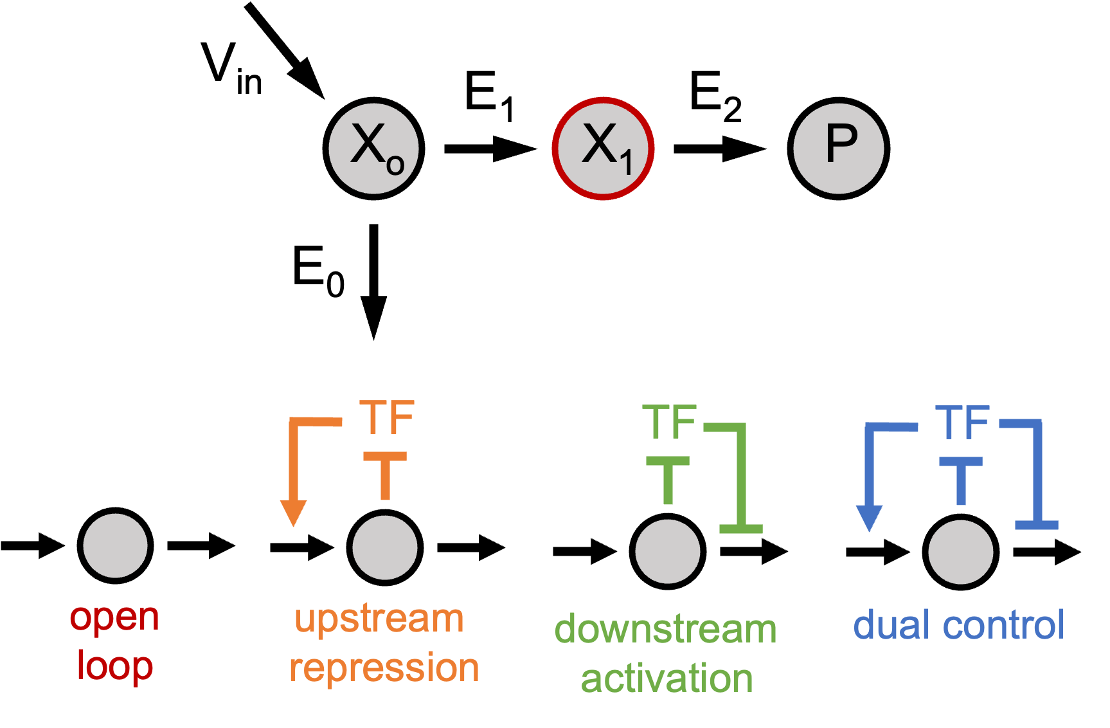


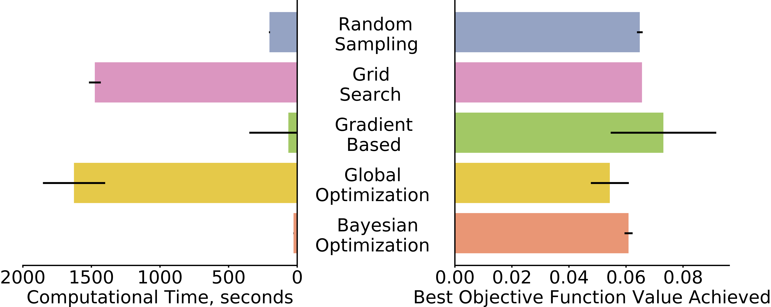


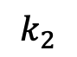
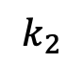
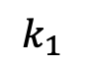
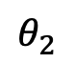
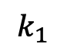
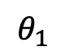
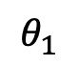
A
B
Sample parameter space
Solve ODE and compute objective function
Fit landscape with nonparametric model
Determine next sample balancing exploration and exploitation
$$θ_{2}$$
C
$$k_{2}$$
$$k_{1}$$
$$θ_{1}$$
$$k_{1}$$
$$k_{2}$$
$$k_{1}$$
$$θ_{1}$$

Slide 3
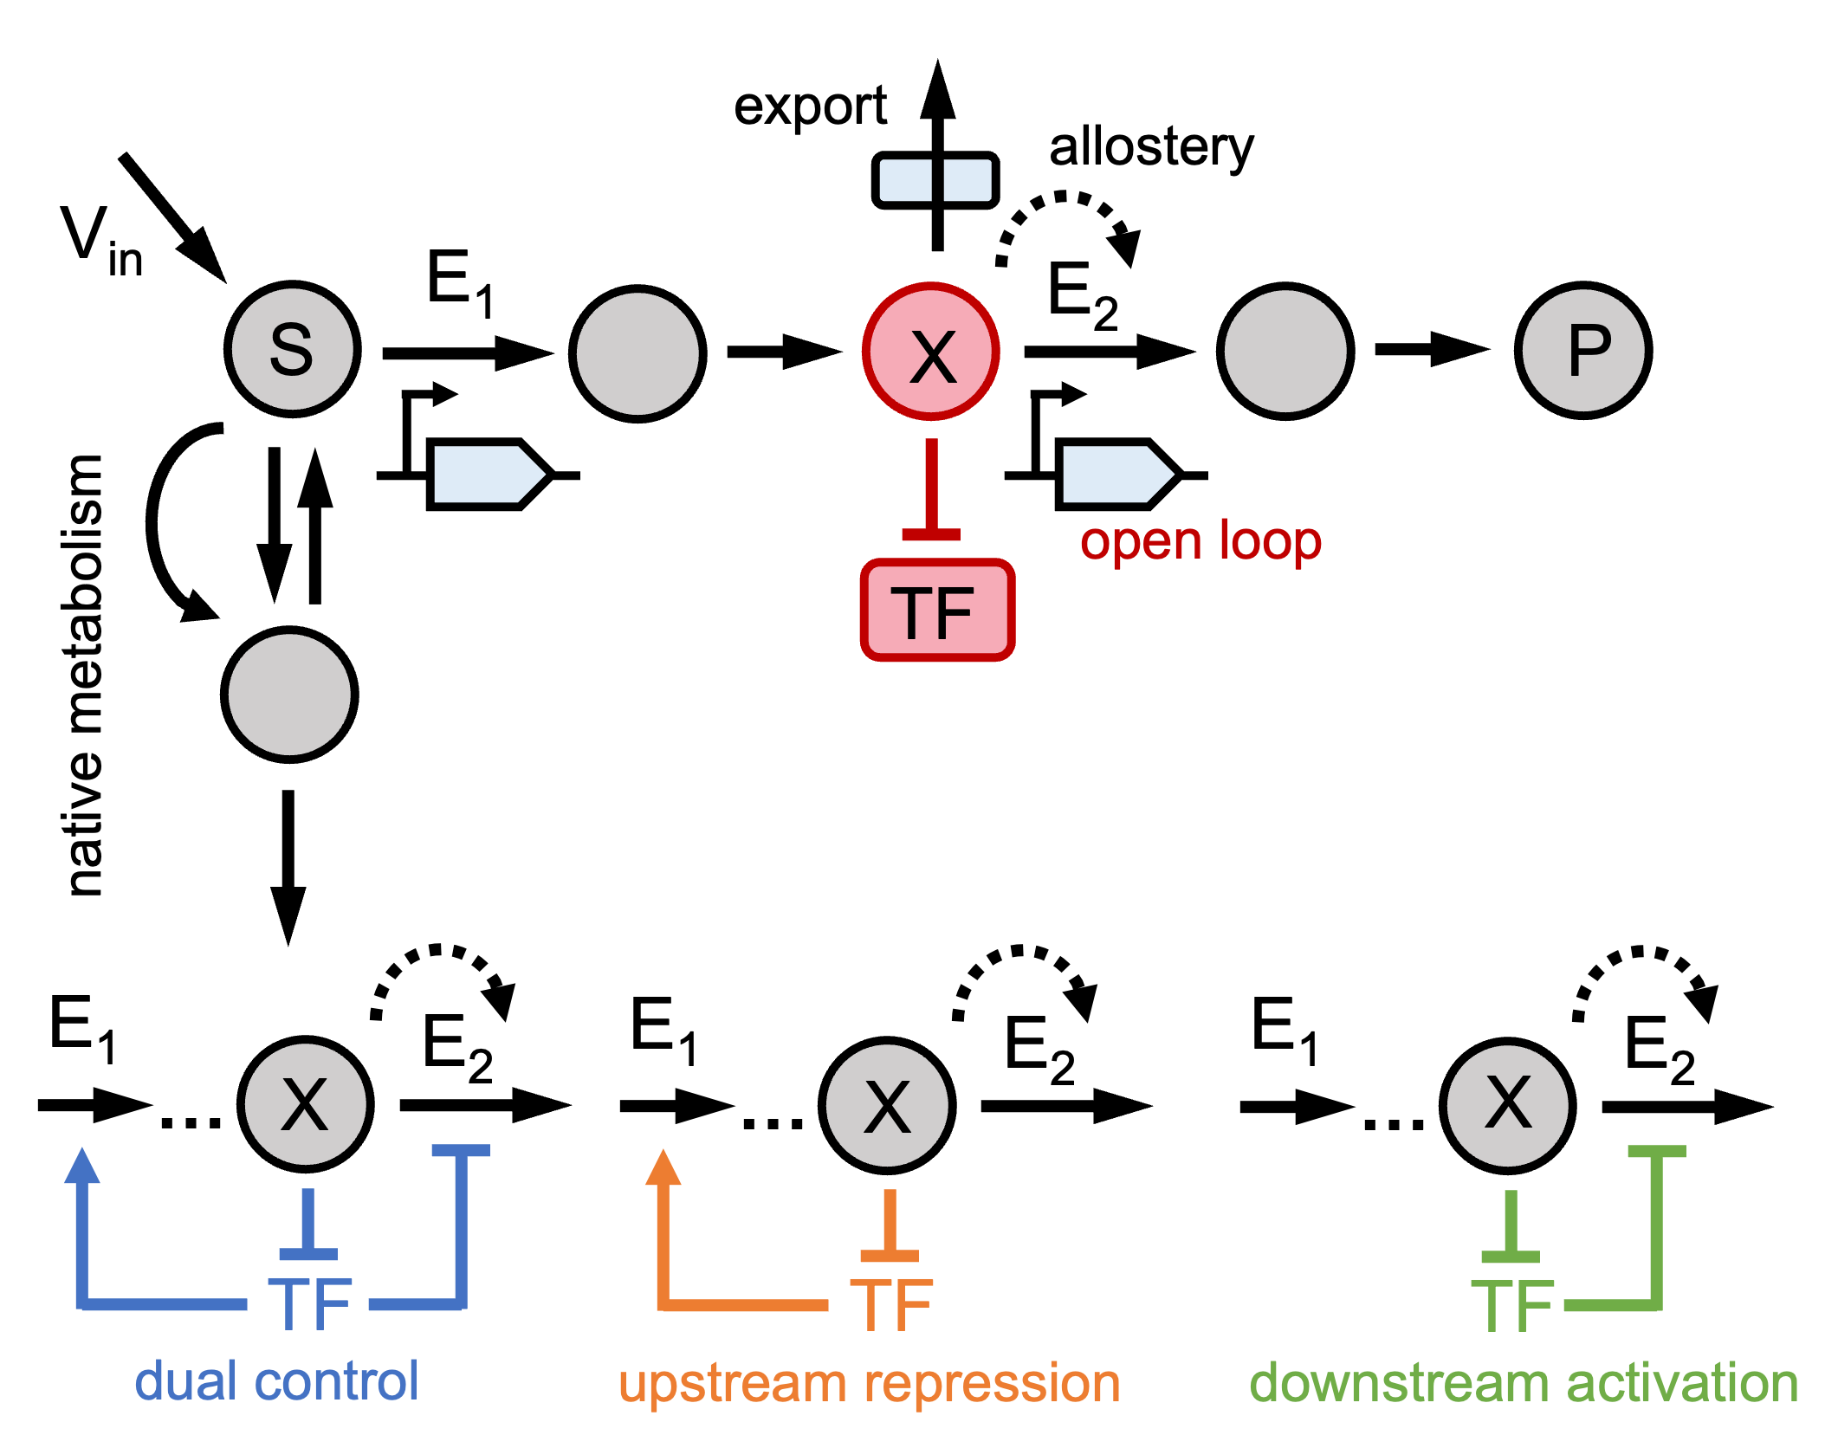
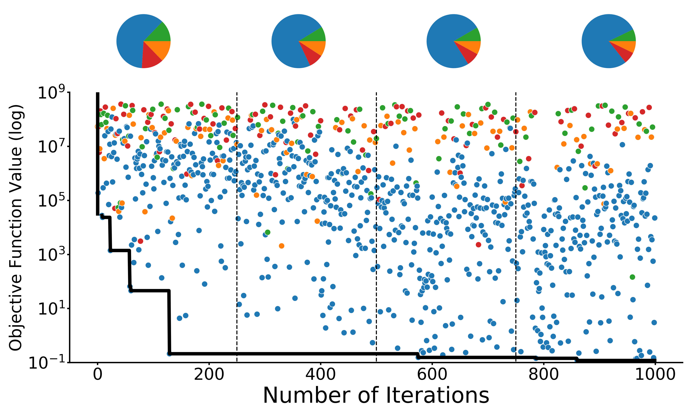
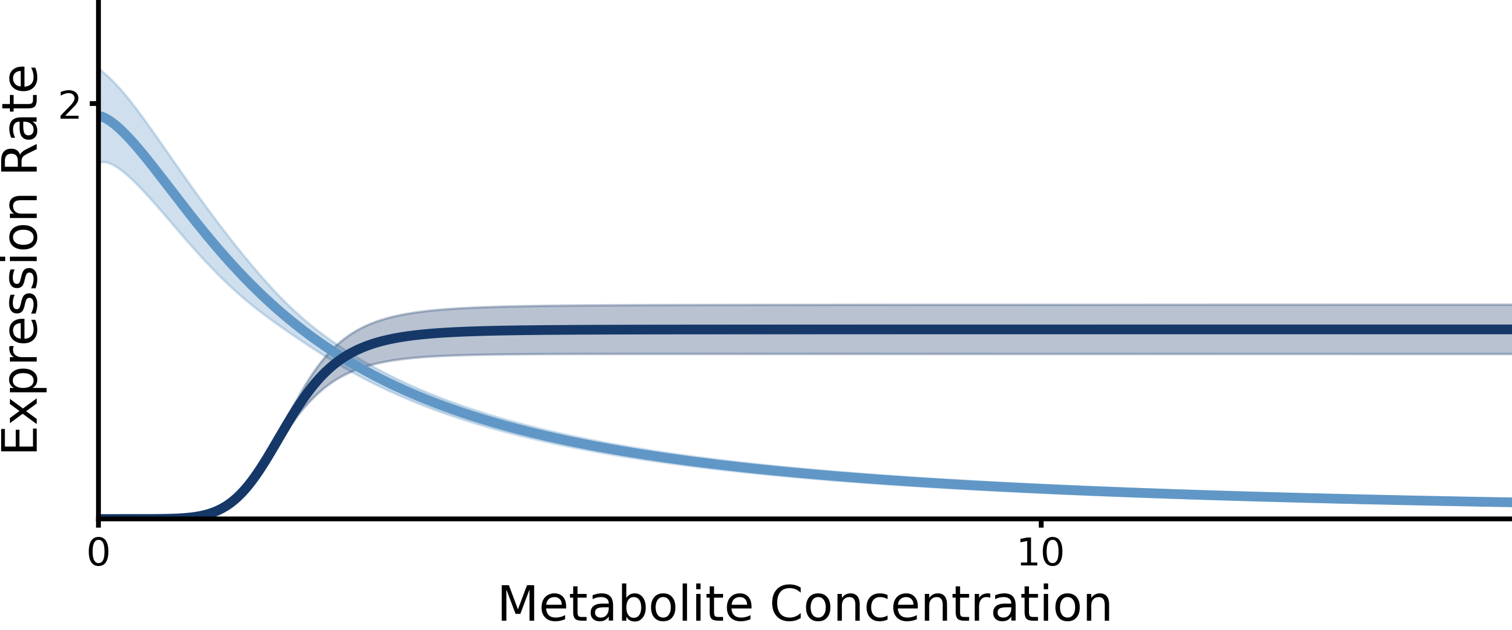
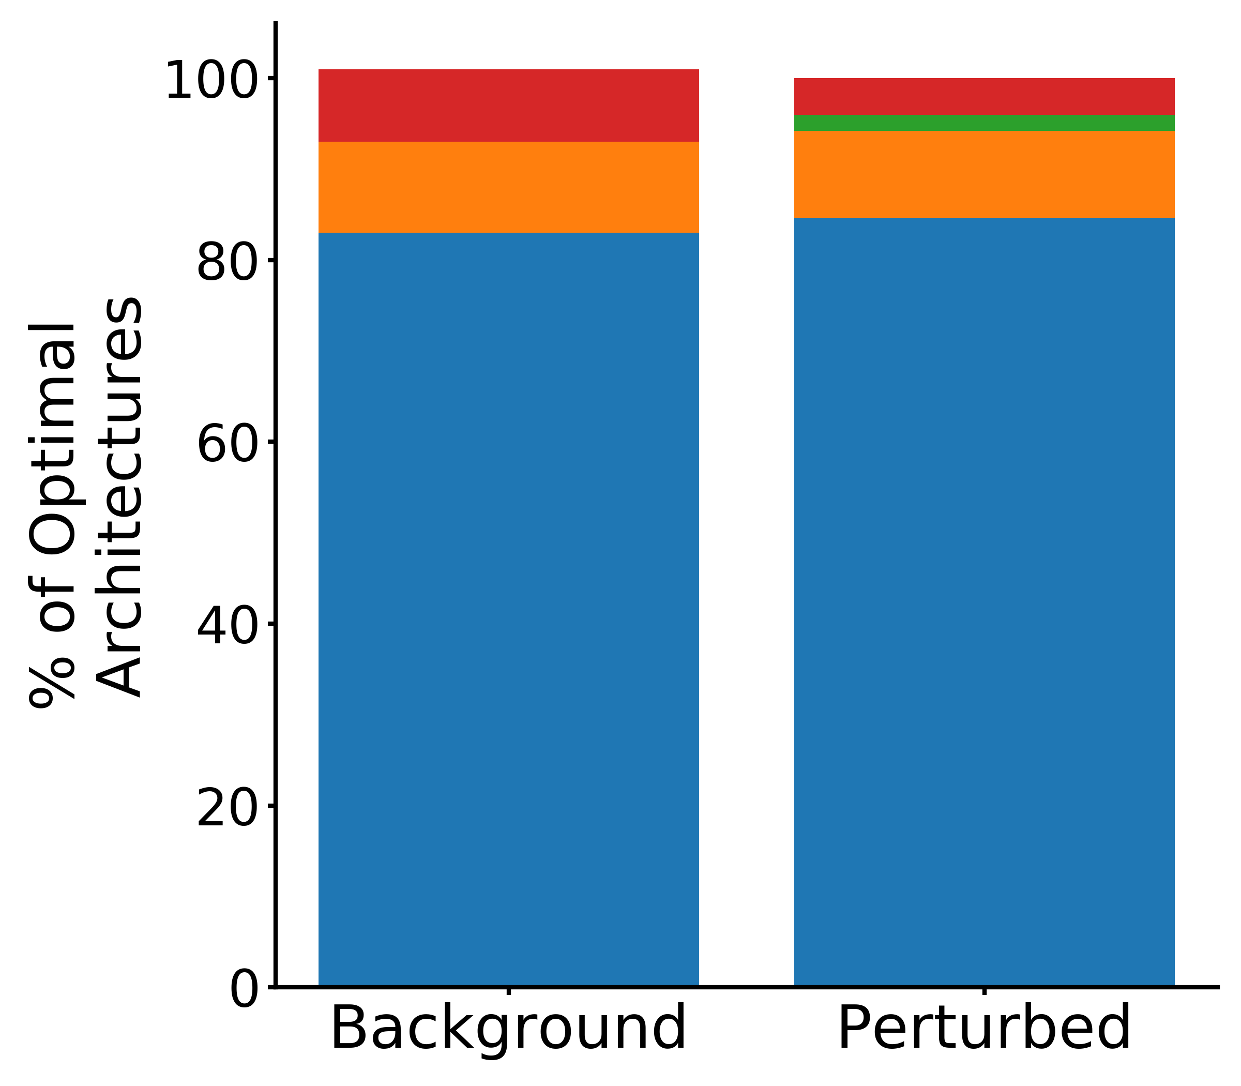
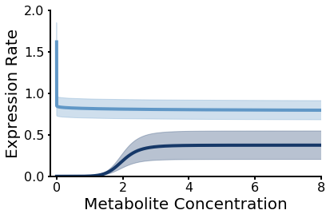
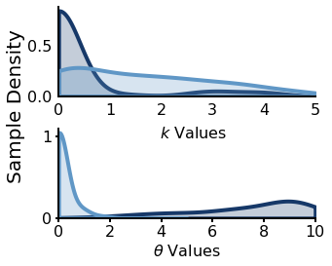
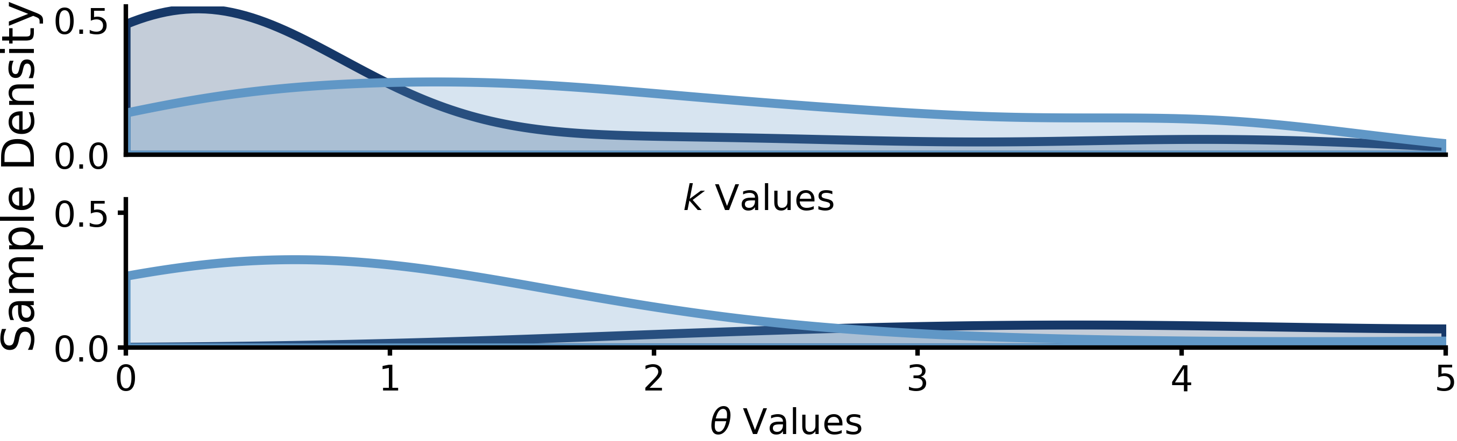
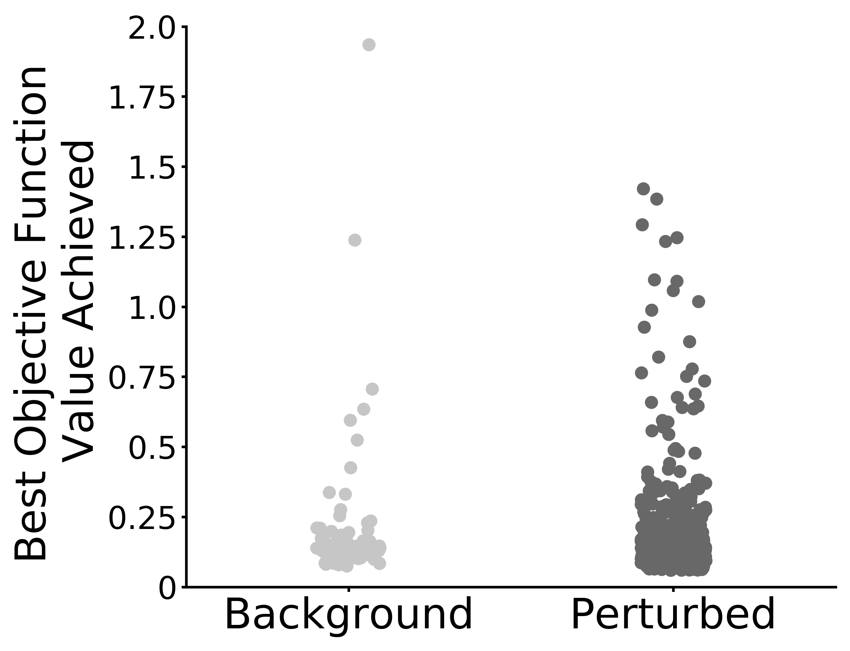
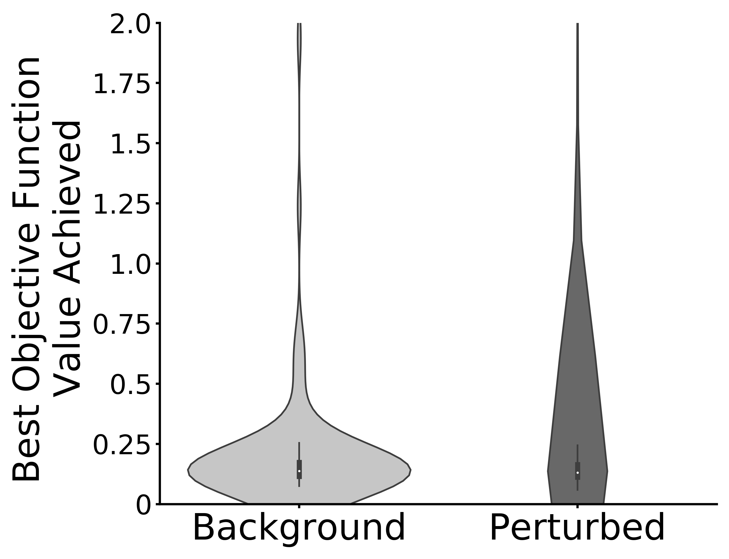
A
B
C
D
E
upstream loop
downstream loop

Slide 4
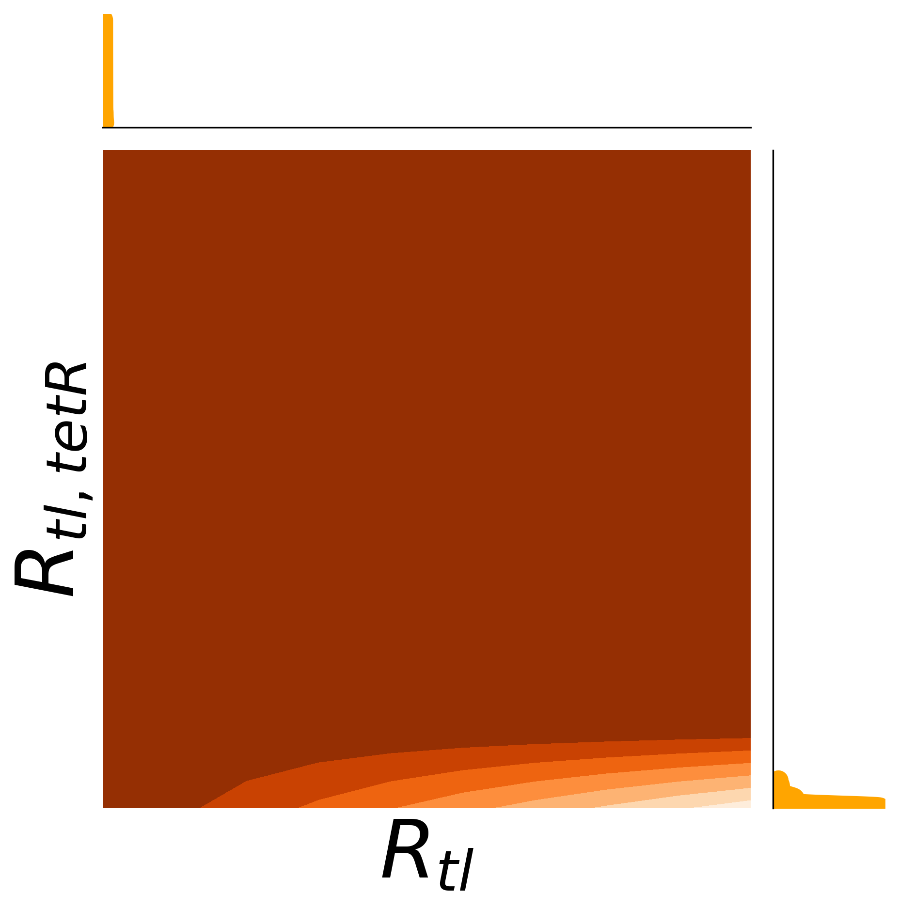
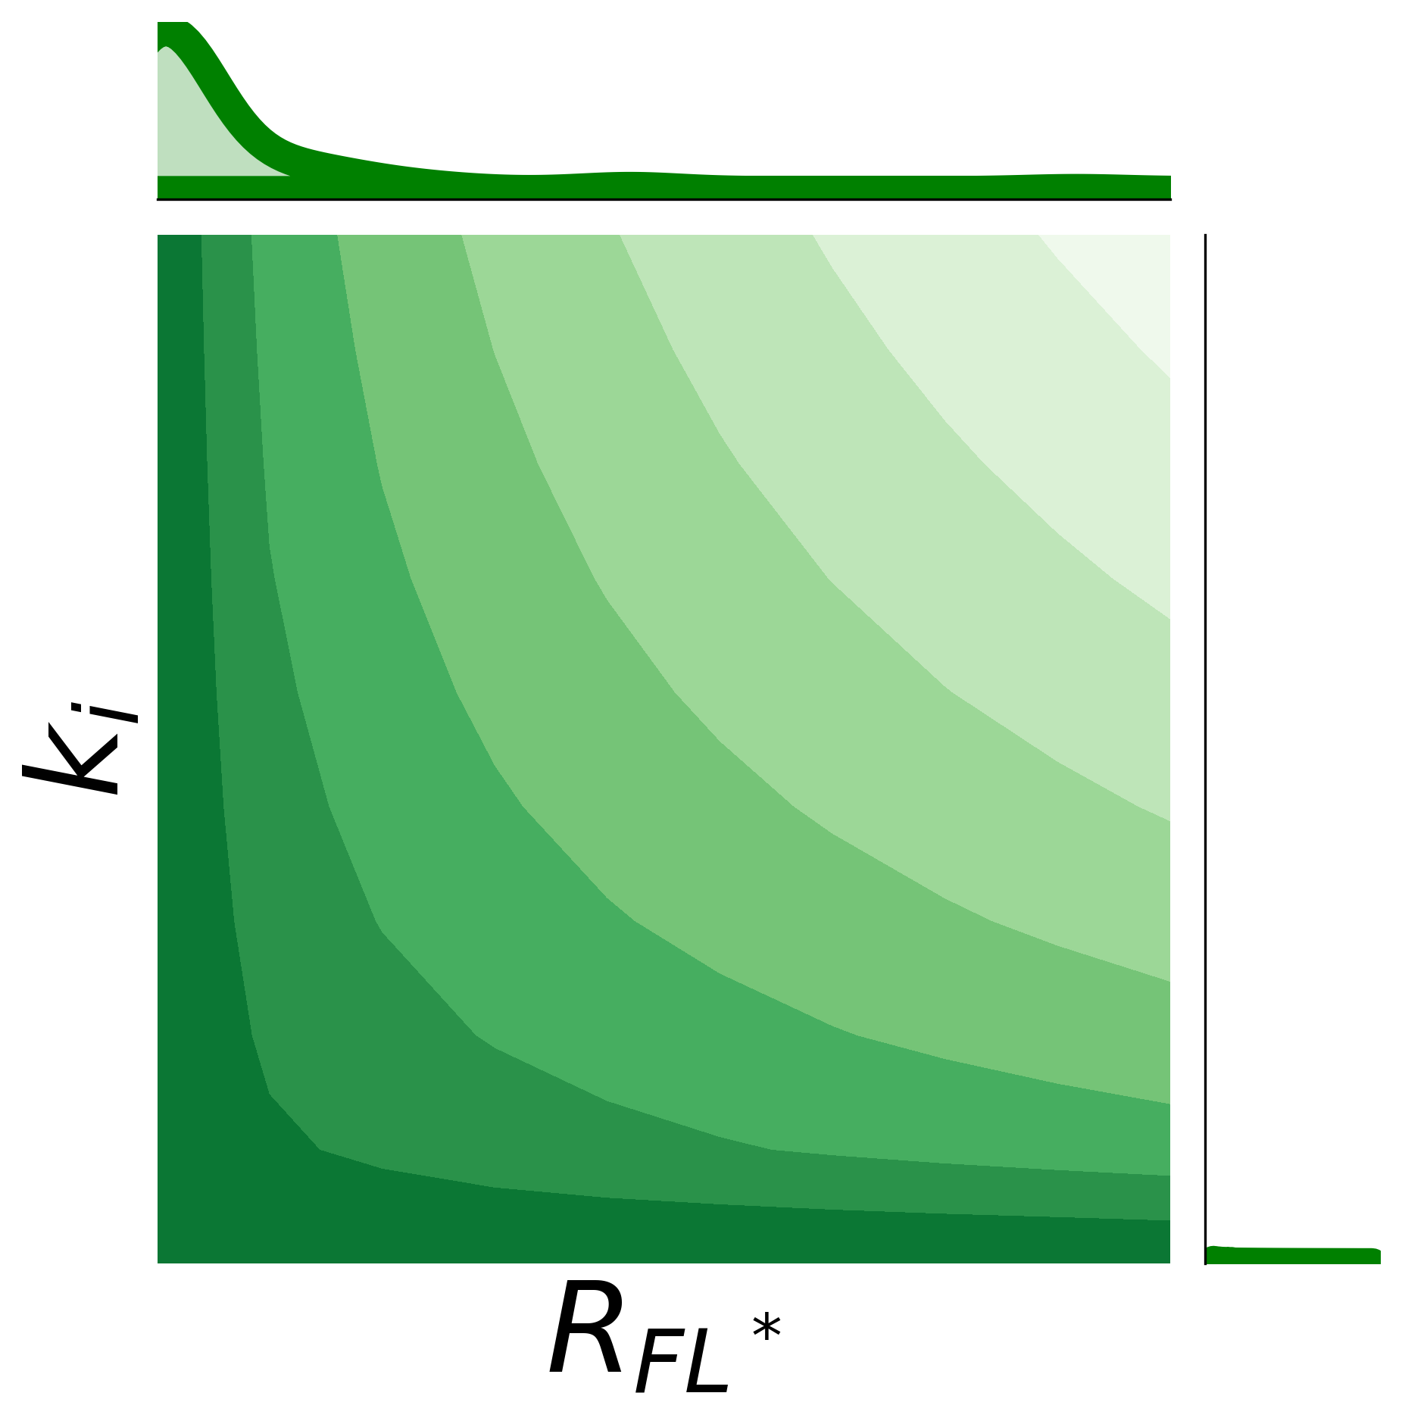
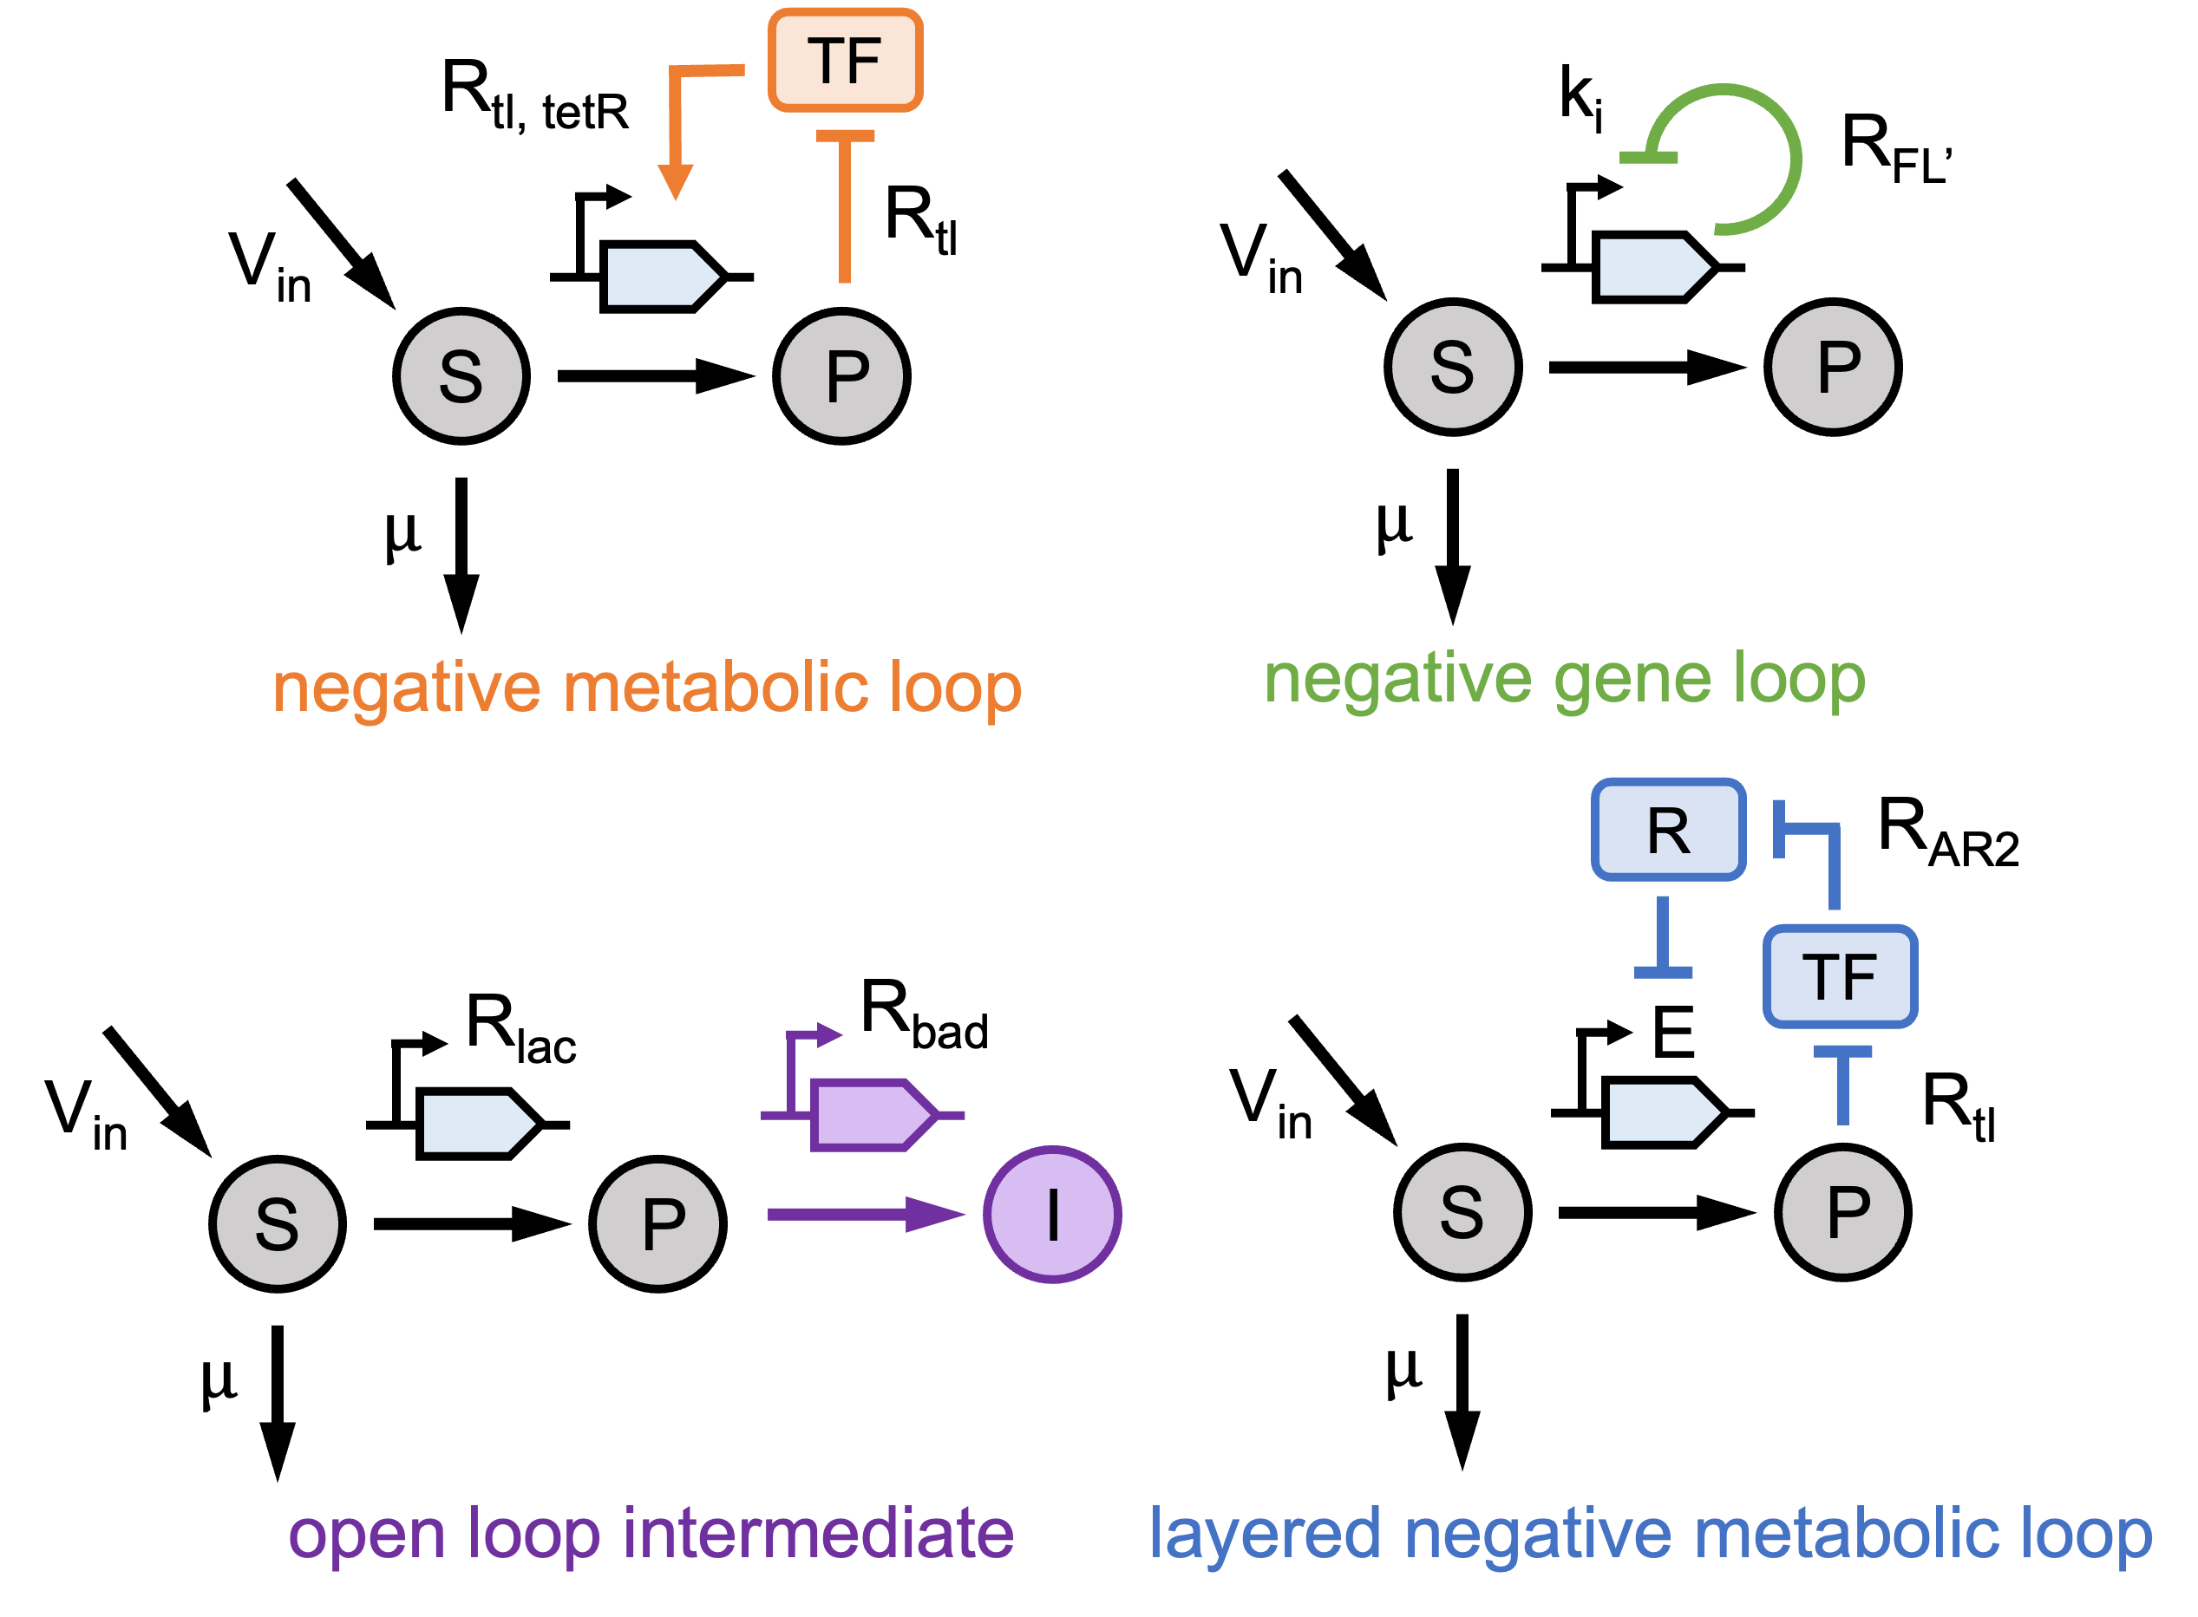
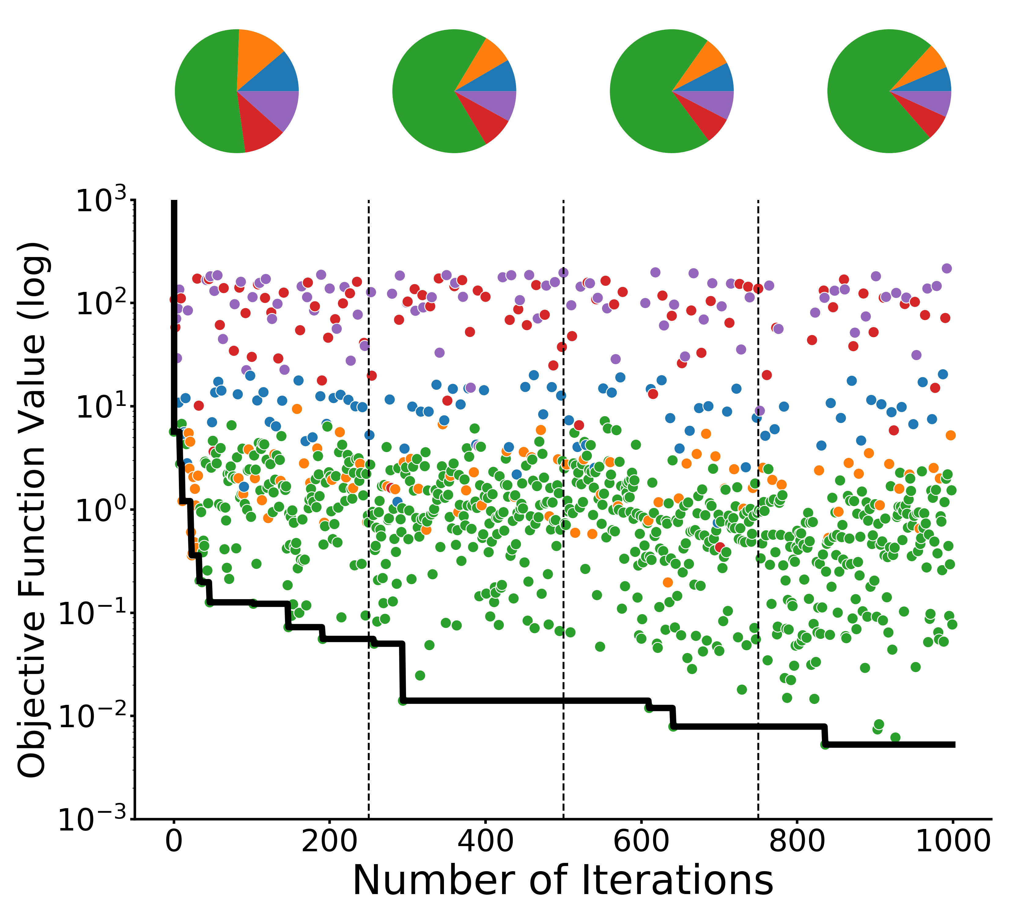
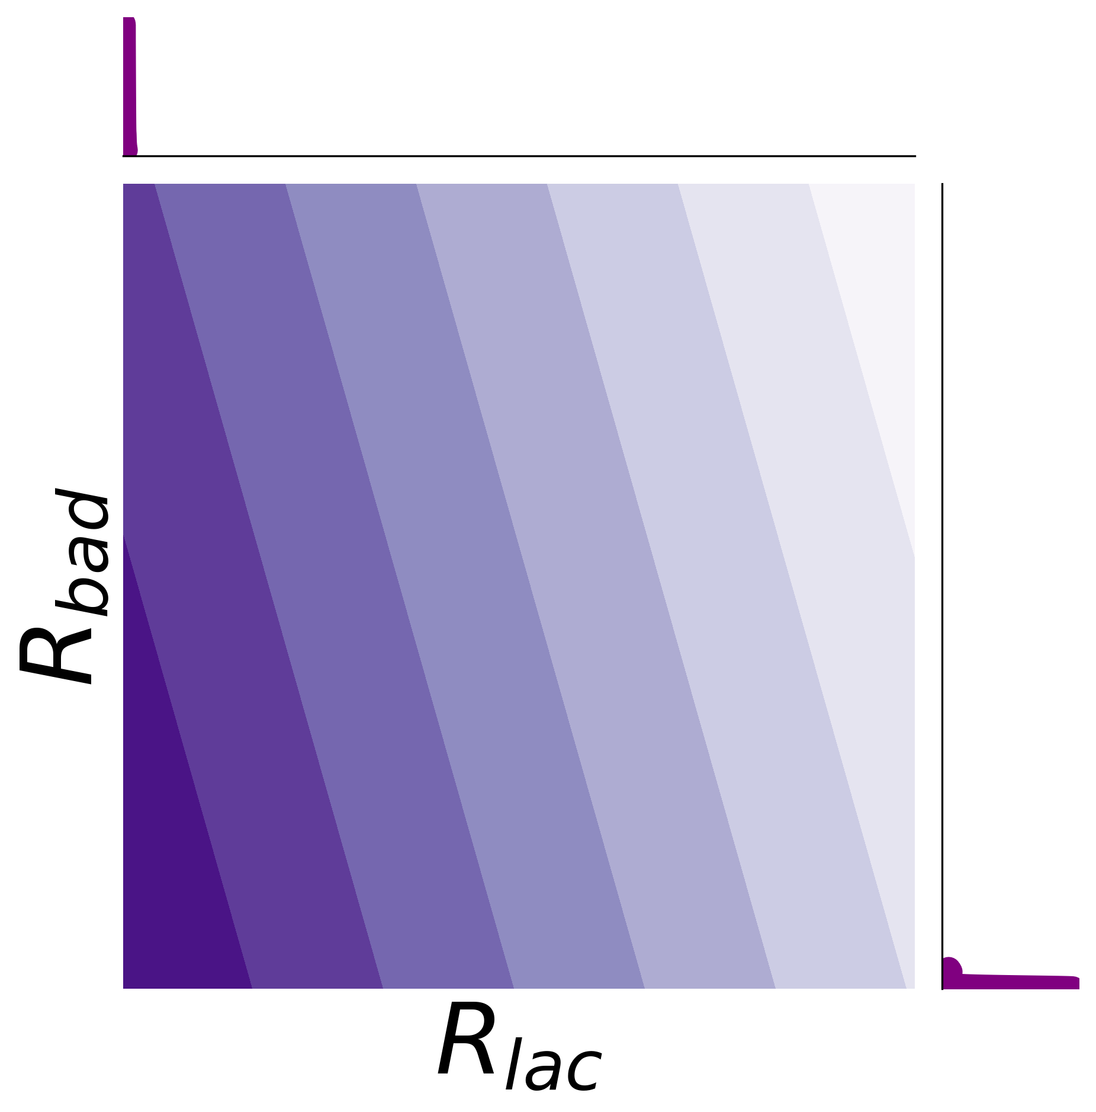
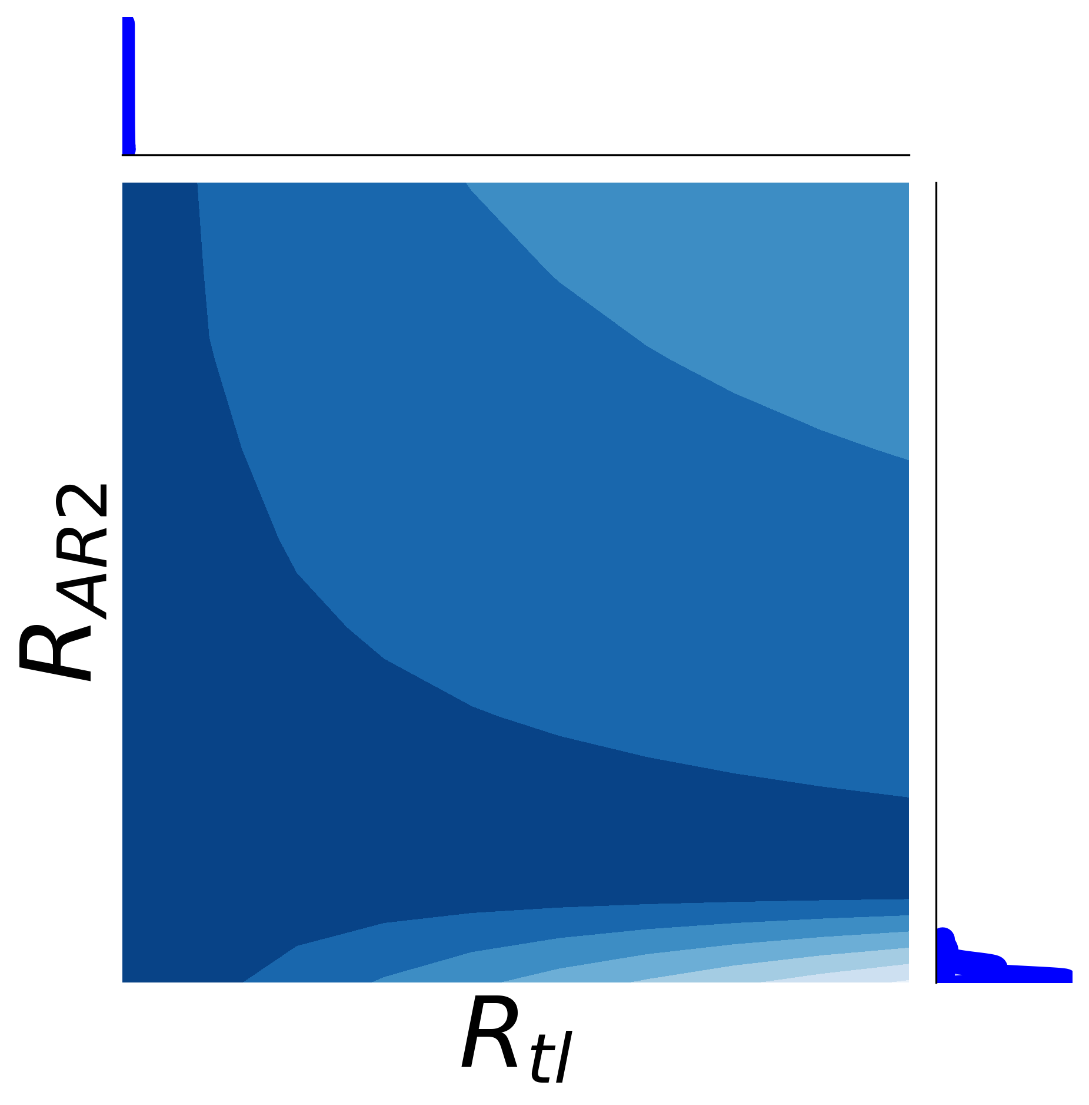
A
B
C

Slide 5
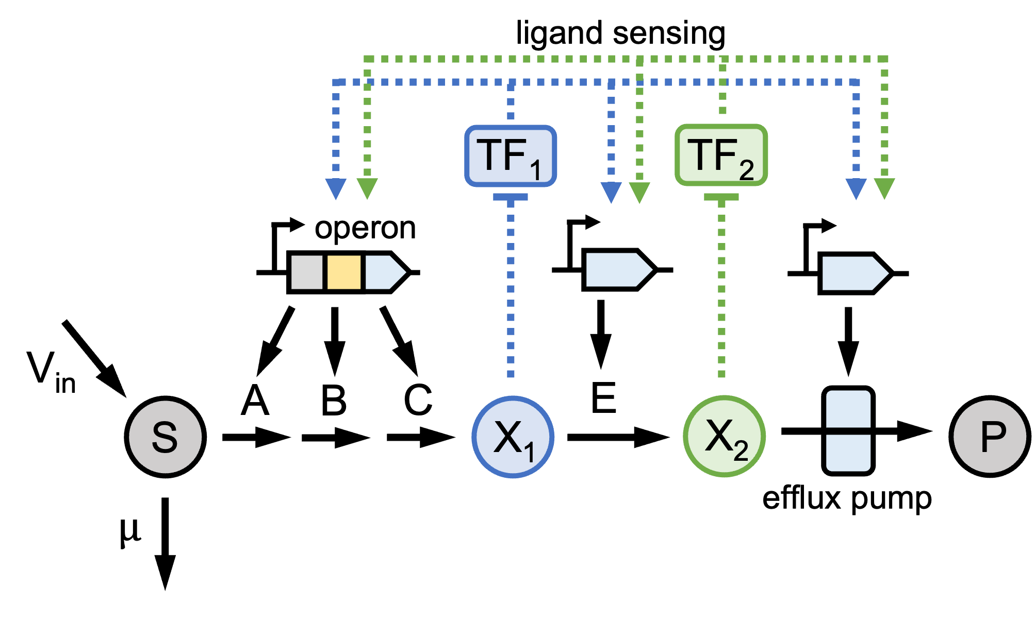
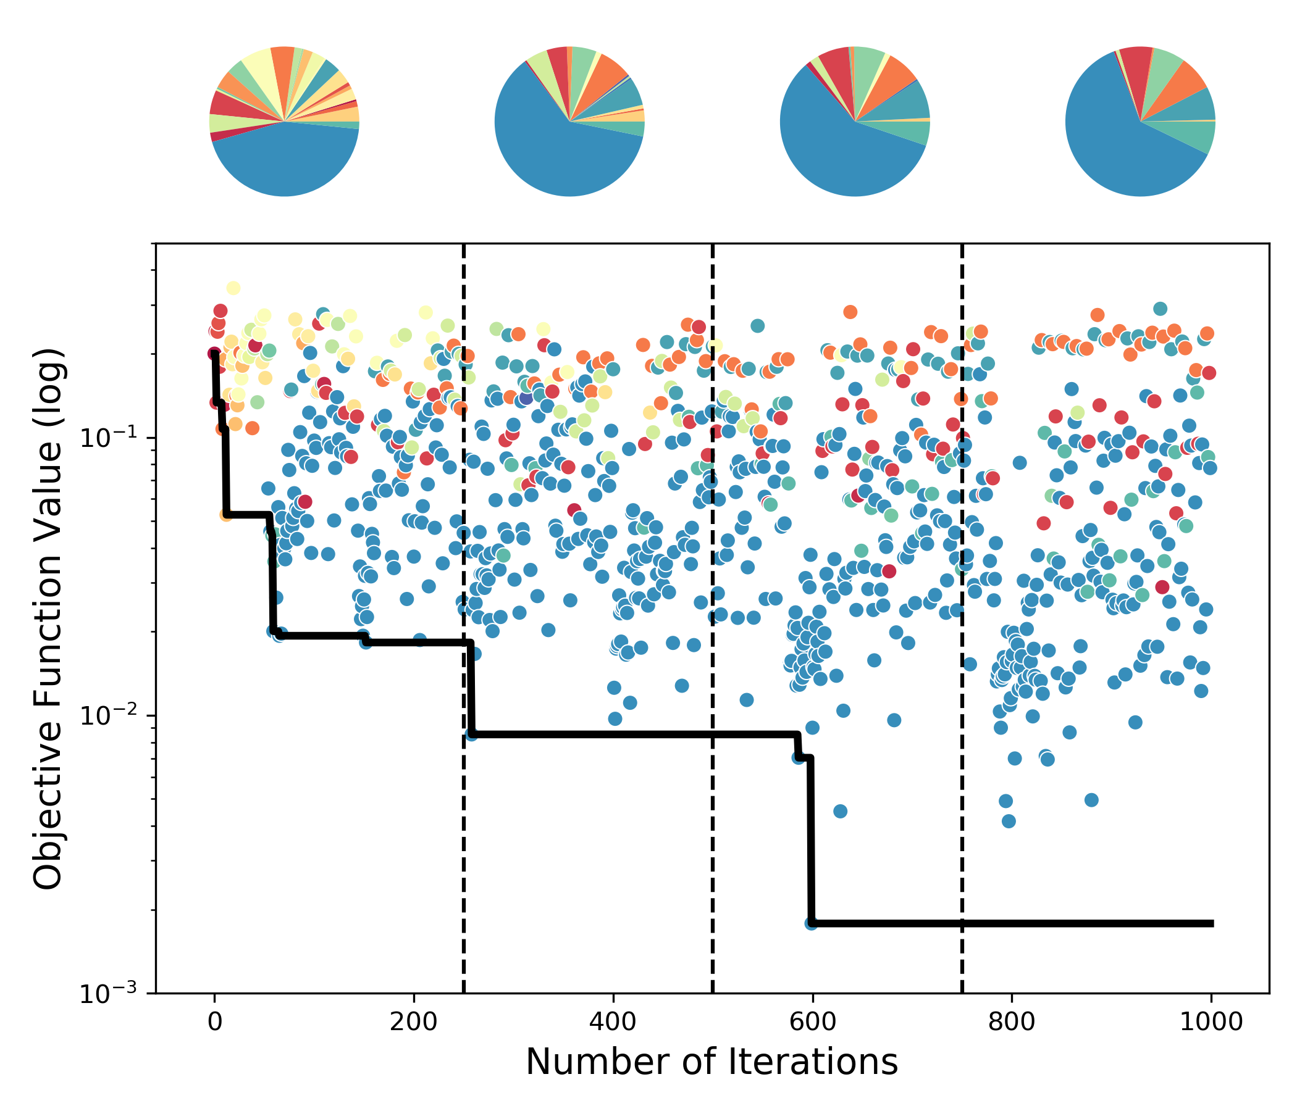
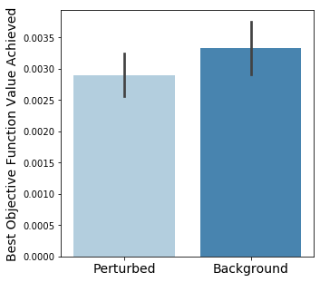
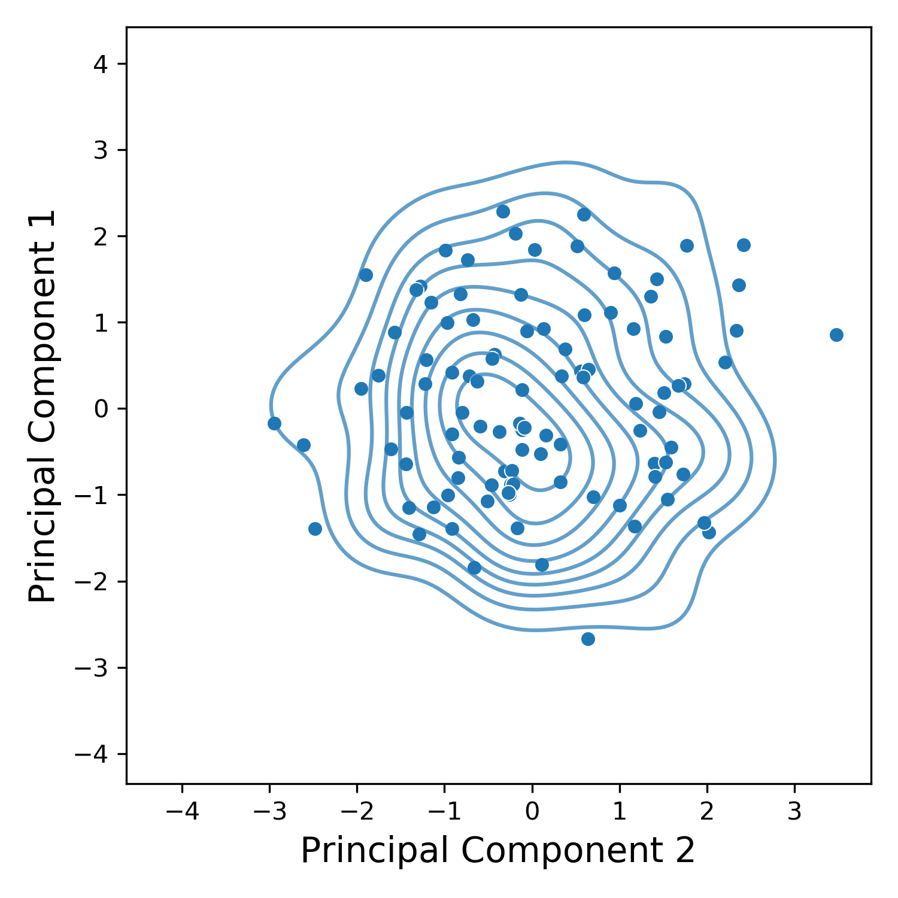
A
B
C
D

Slide 6
Supplementary Figures

Slide 7
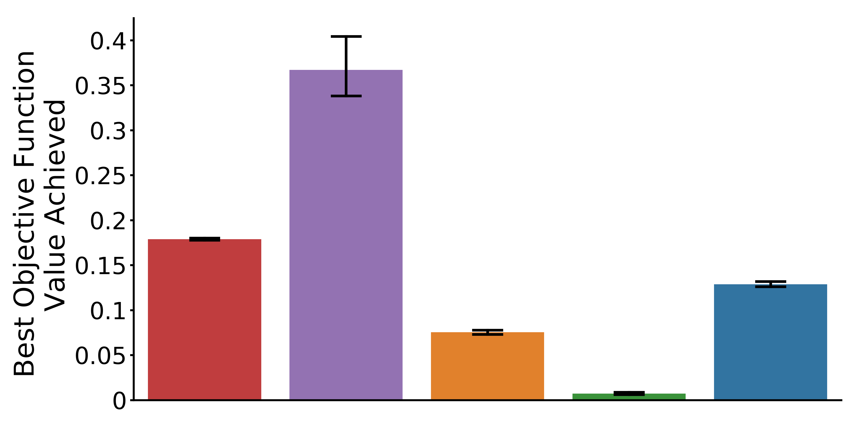
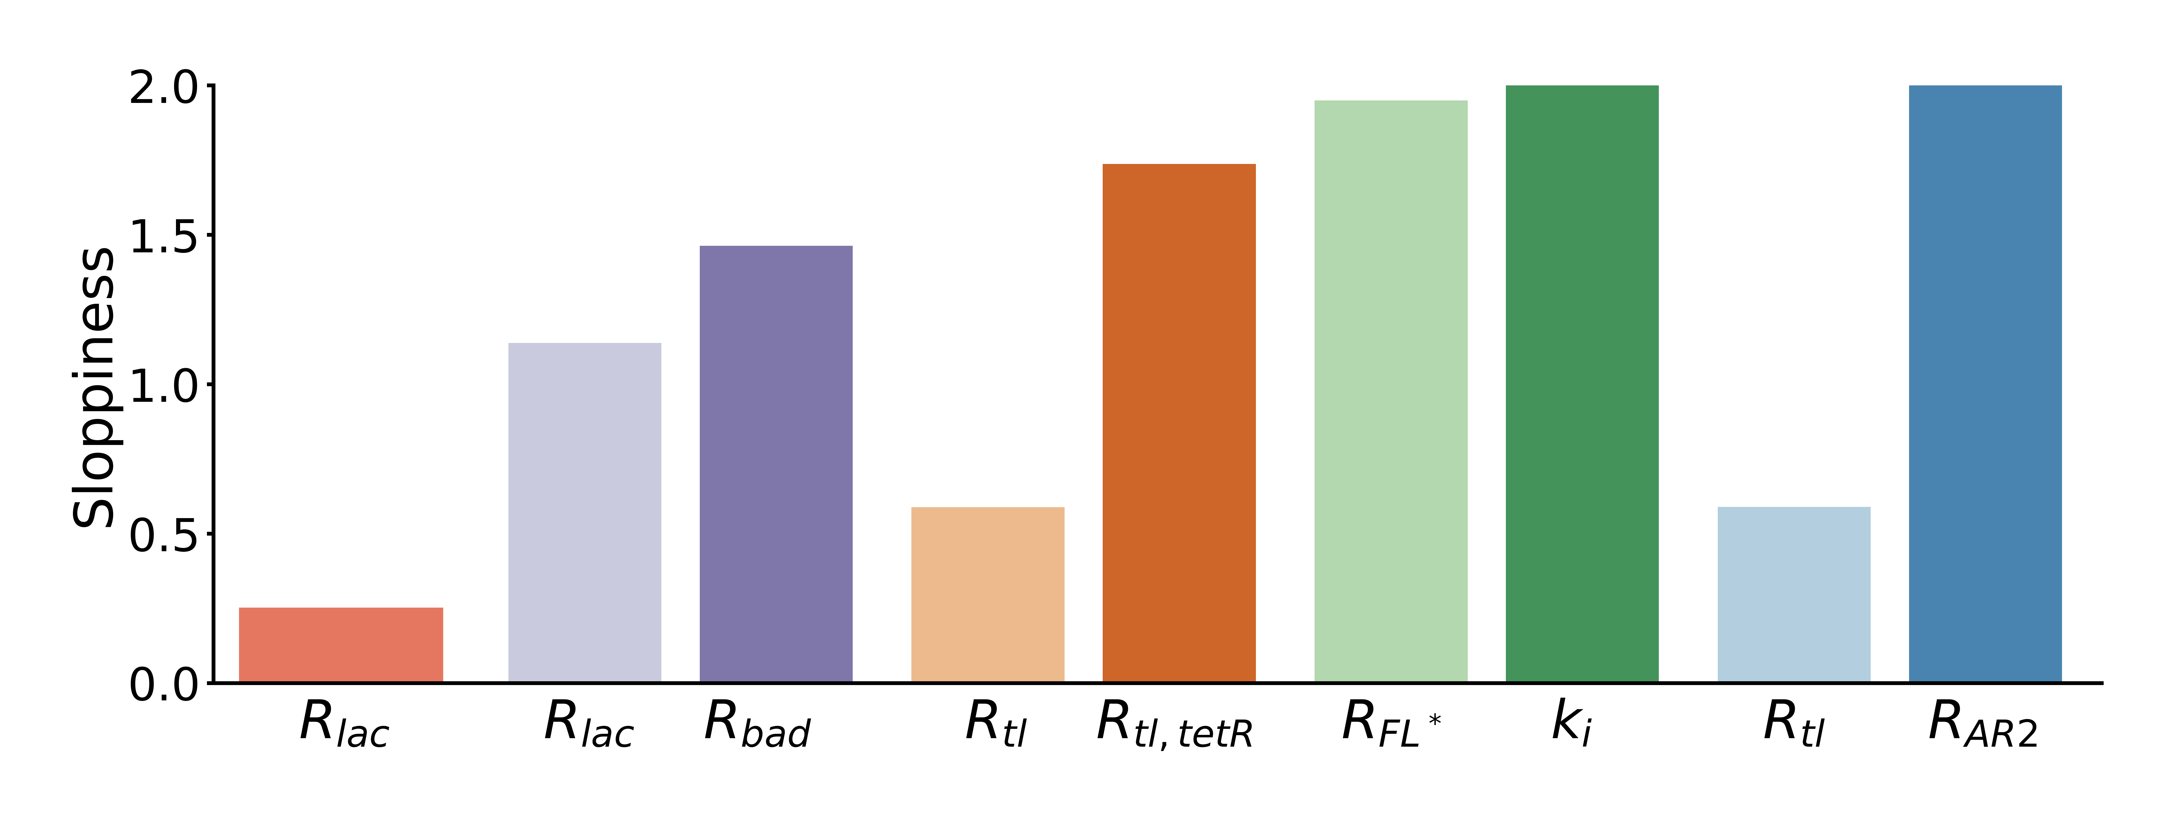
D
E
open loop
open loop intermediate
negative metabolic loop
negative gene loop
layered negative metabolic loop

Slide 8
Alternate/Old Figures

Slide 9
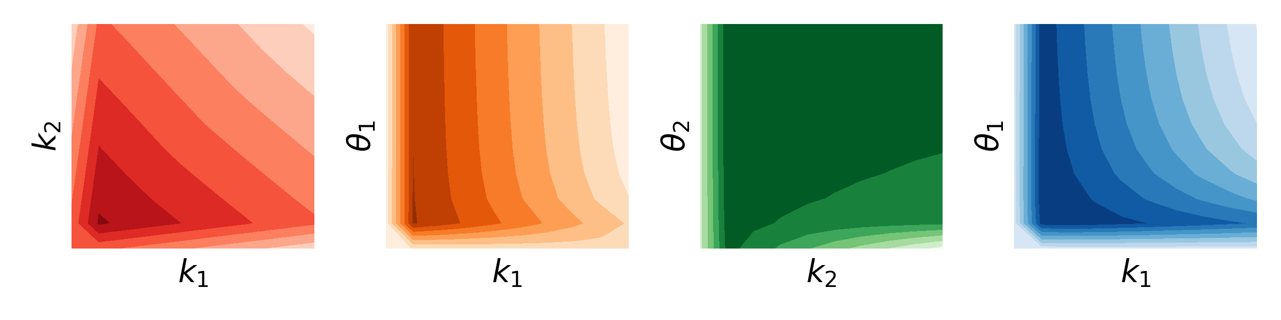
A
C
Sample parameter space
Solve ODE and compute objective function
Fit landscape with nonparametric model
B
Determine next sample balancing exploration and exploitation

Slide 10
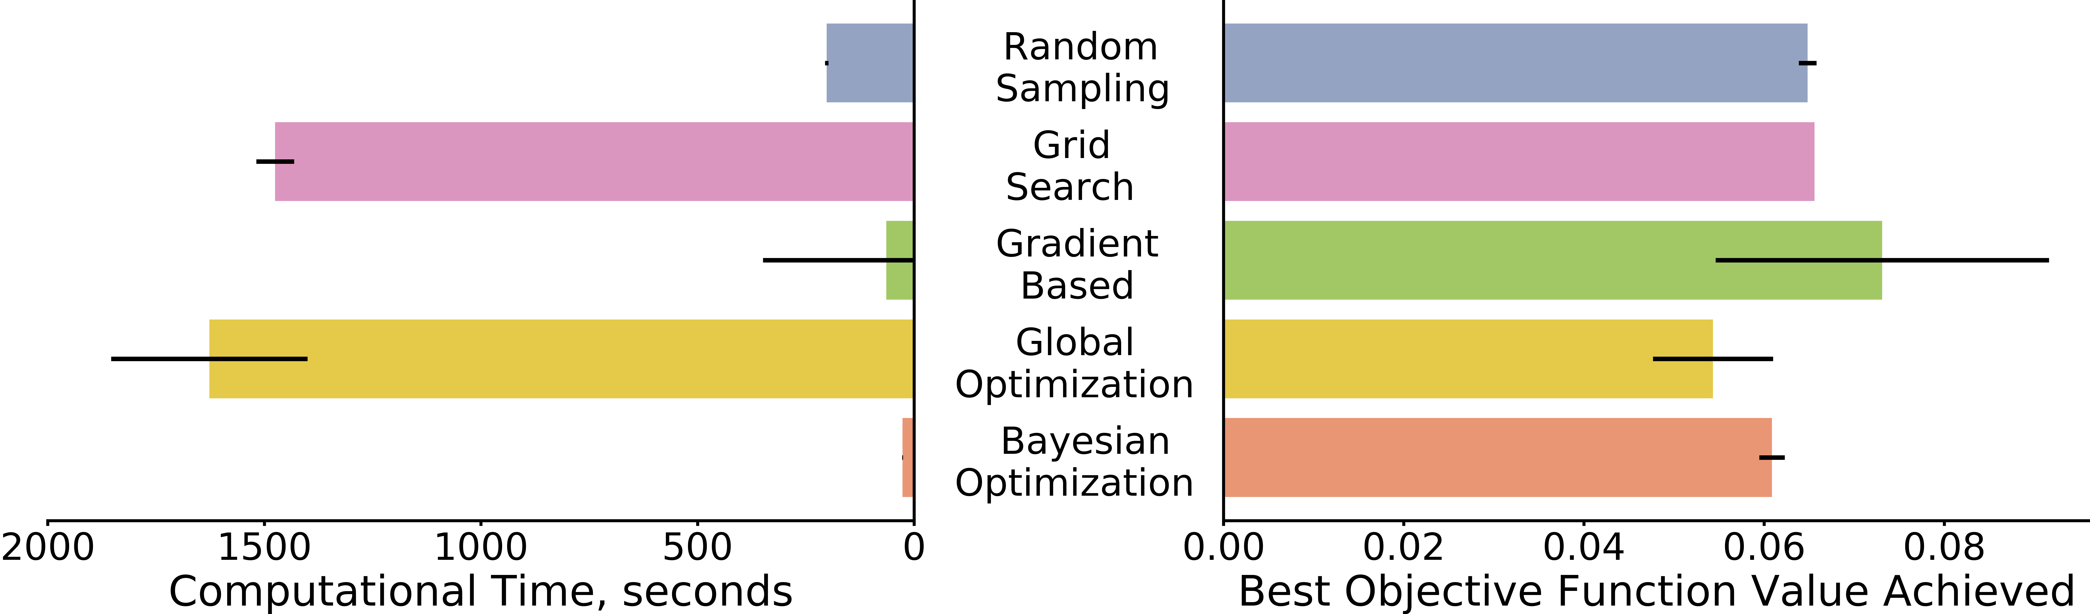
A
C
Sample parameter space
Solve ODE and compute objective function
Fit landscape with nonparametric model
Determine next sample balancing exploration and exploitation
D
B

Slide 12
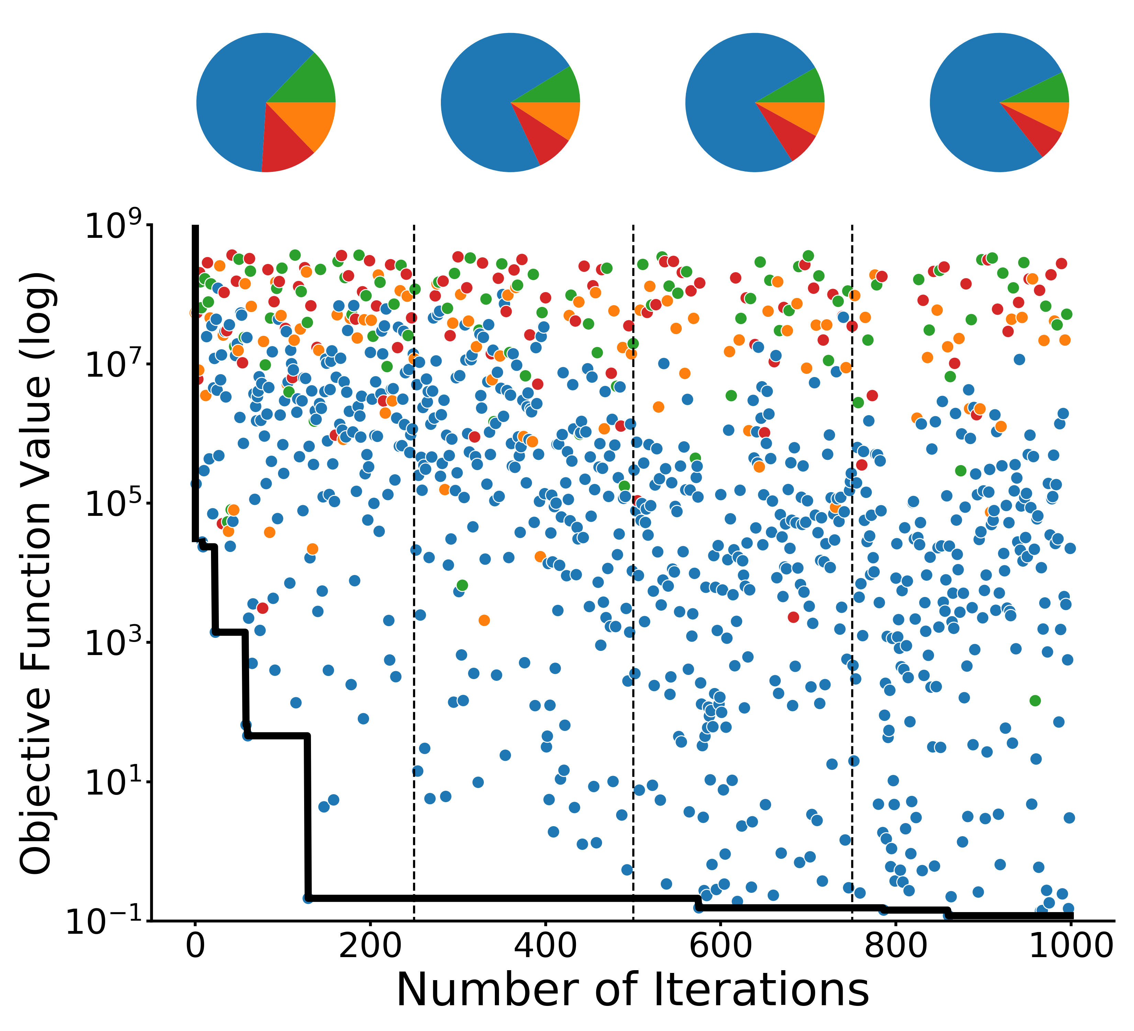
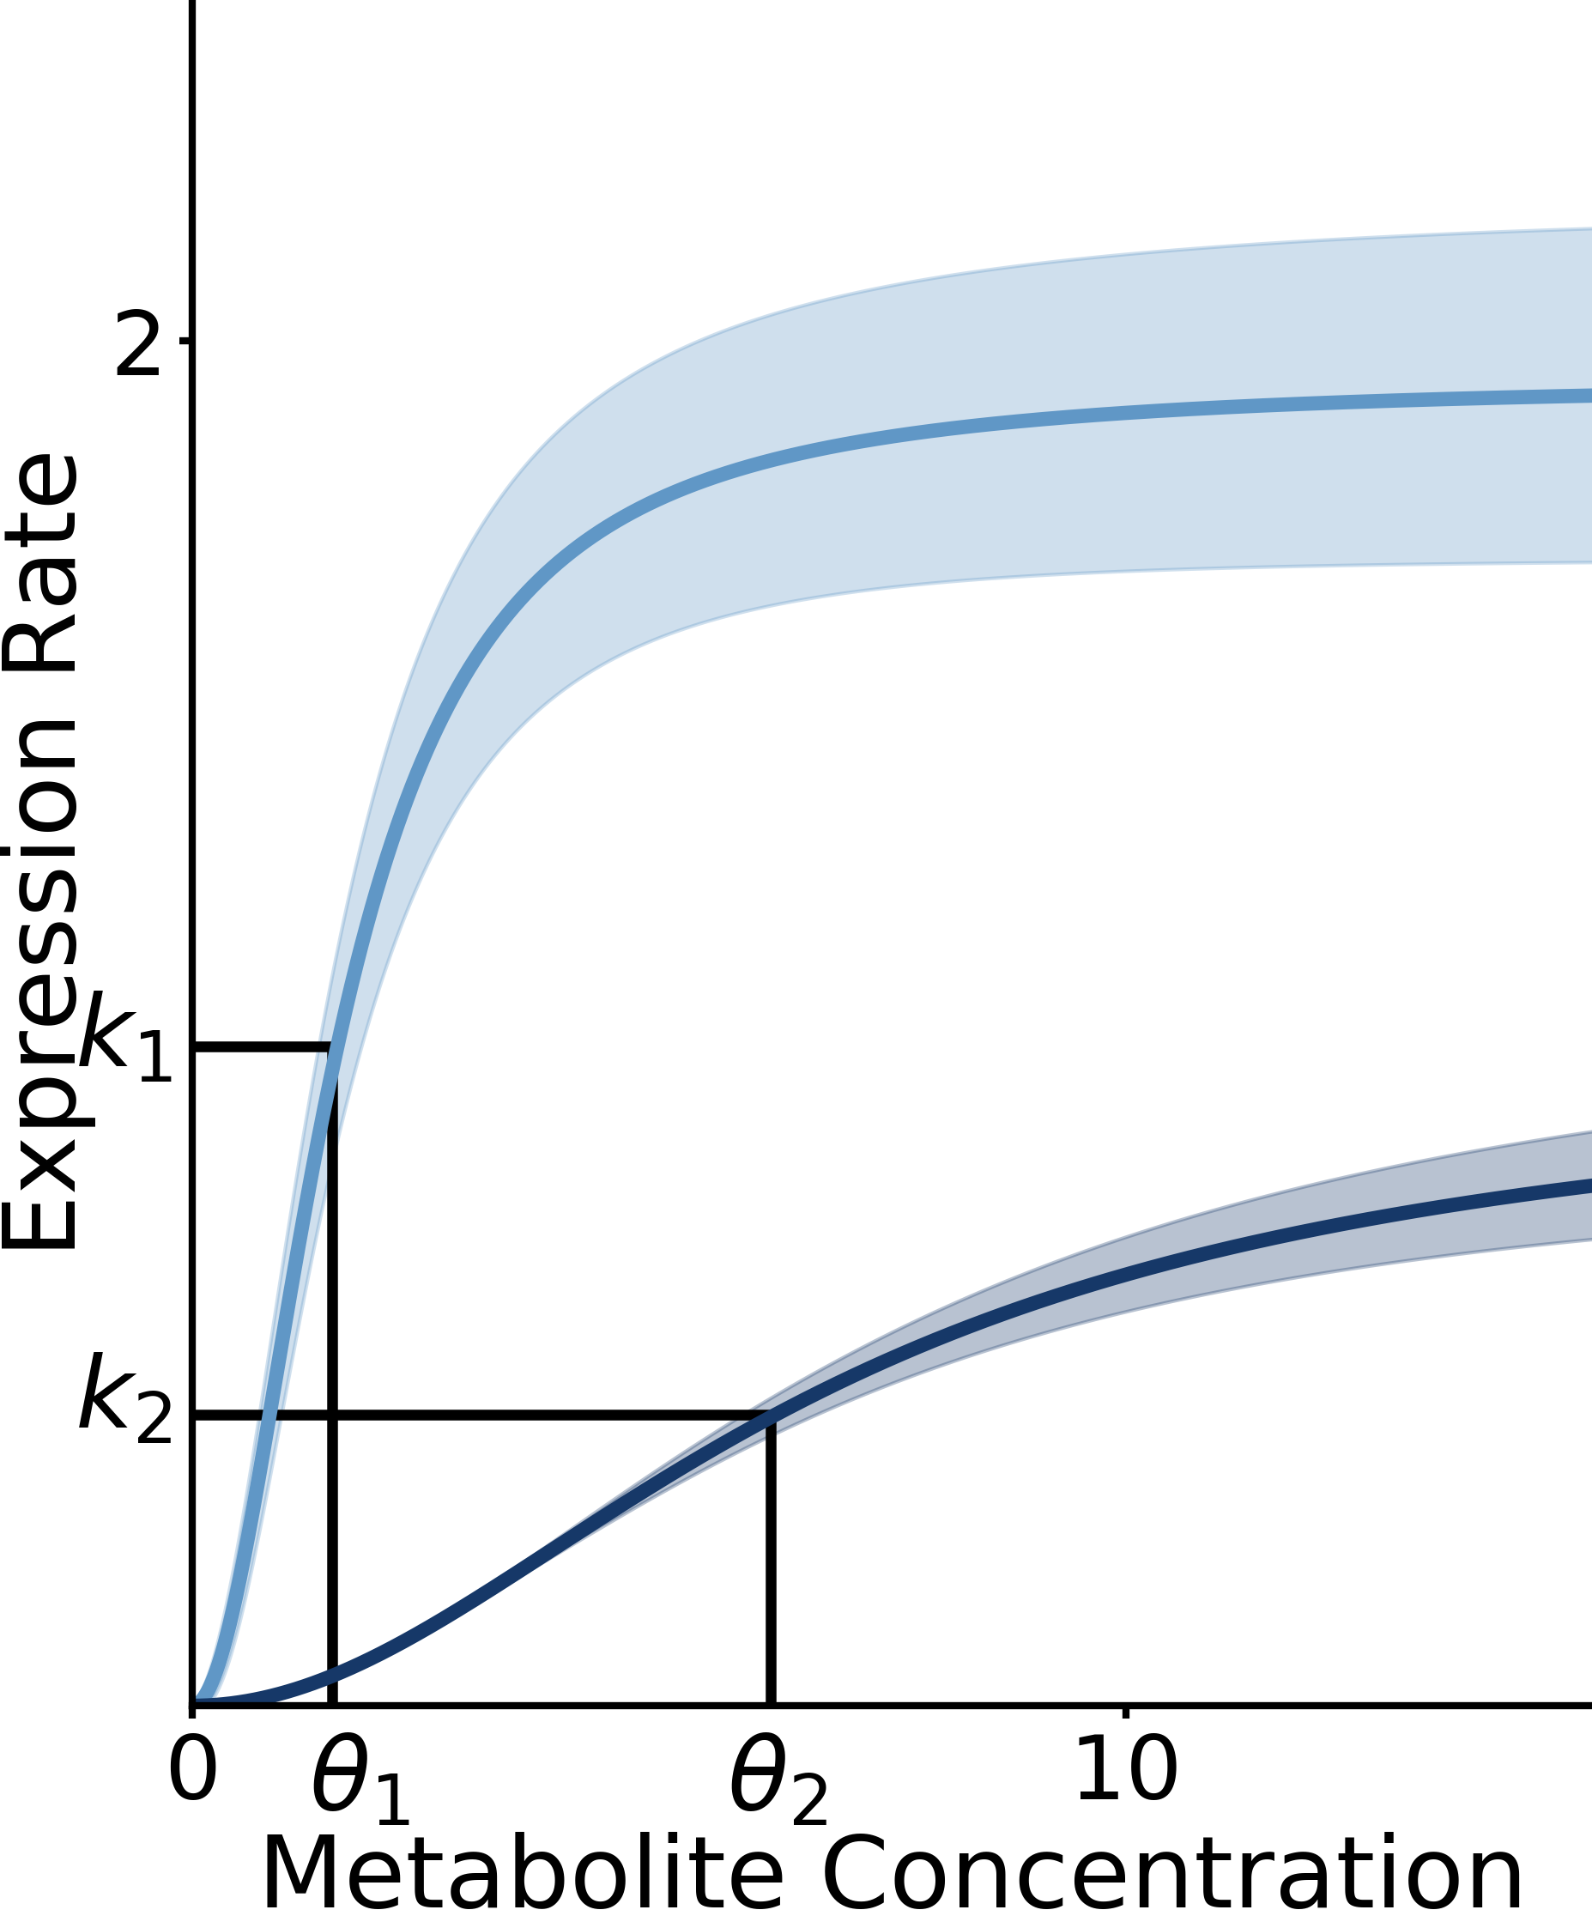
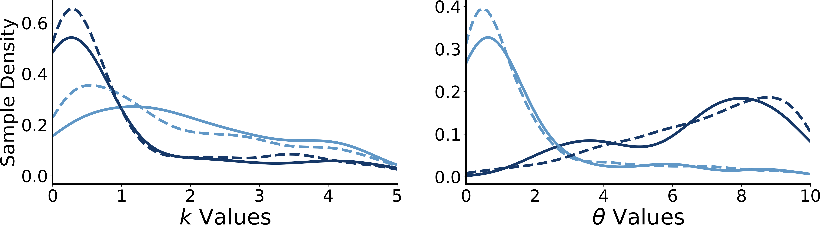
A
B
C
D
E
F
G
downstream loop
background
perturbed
upstream loop
dual control architecture

Slide 13
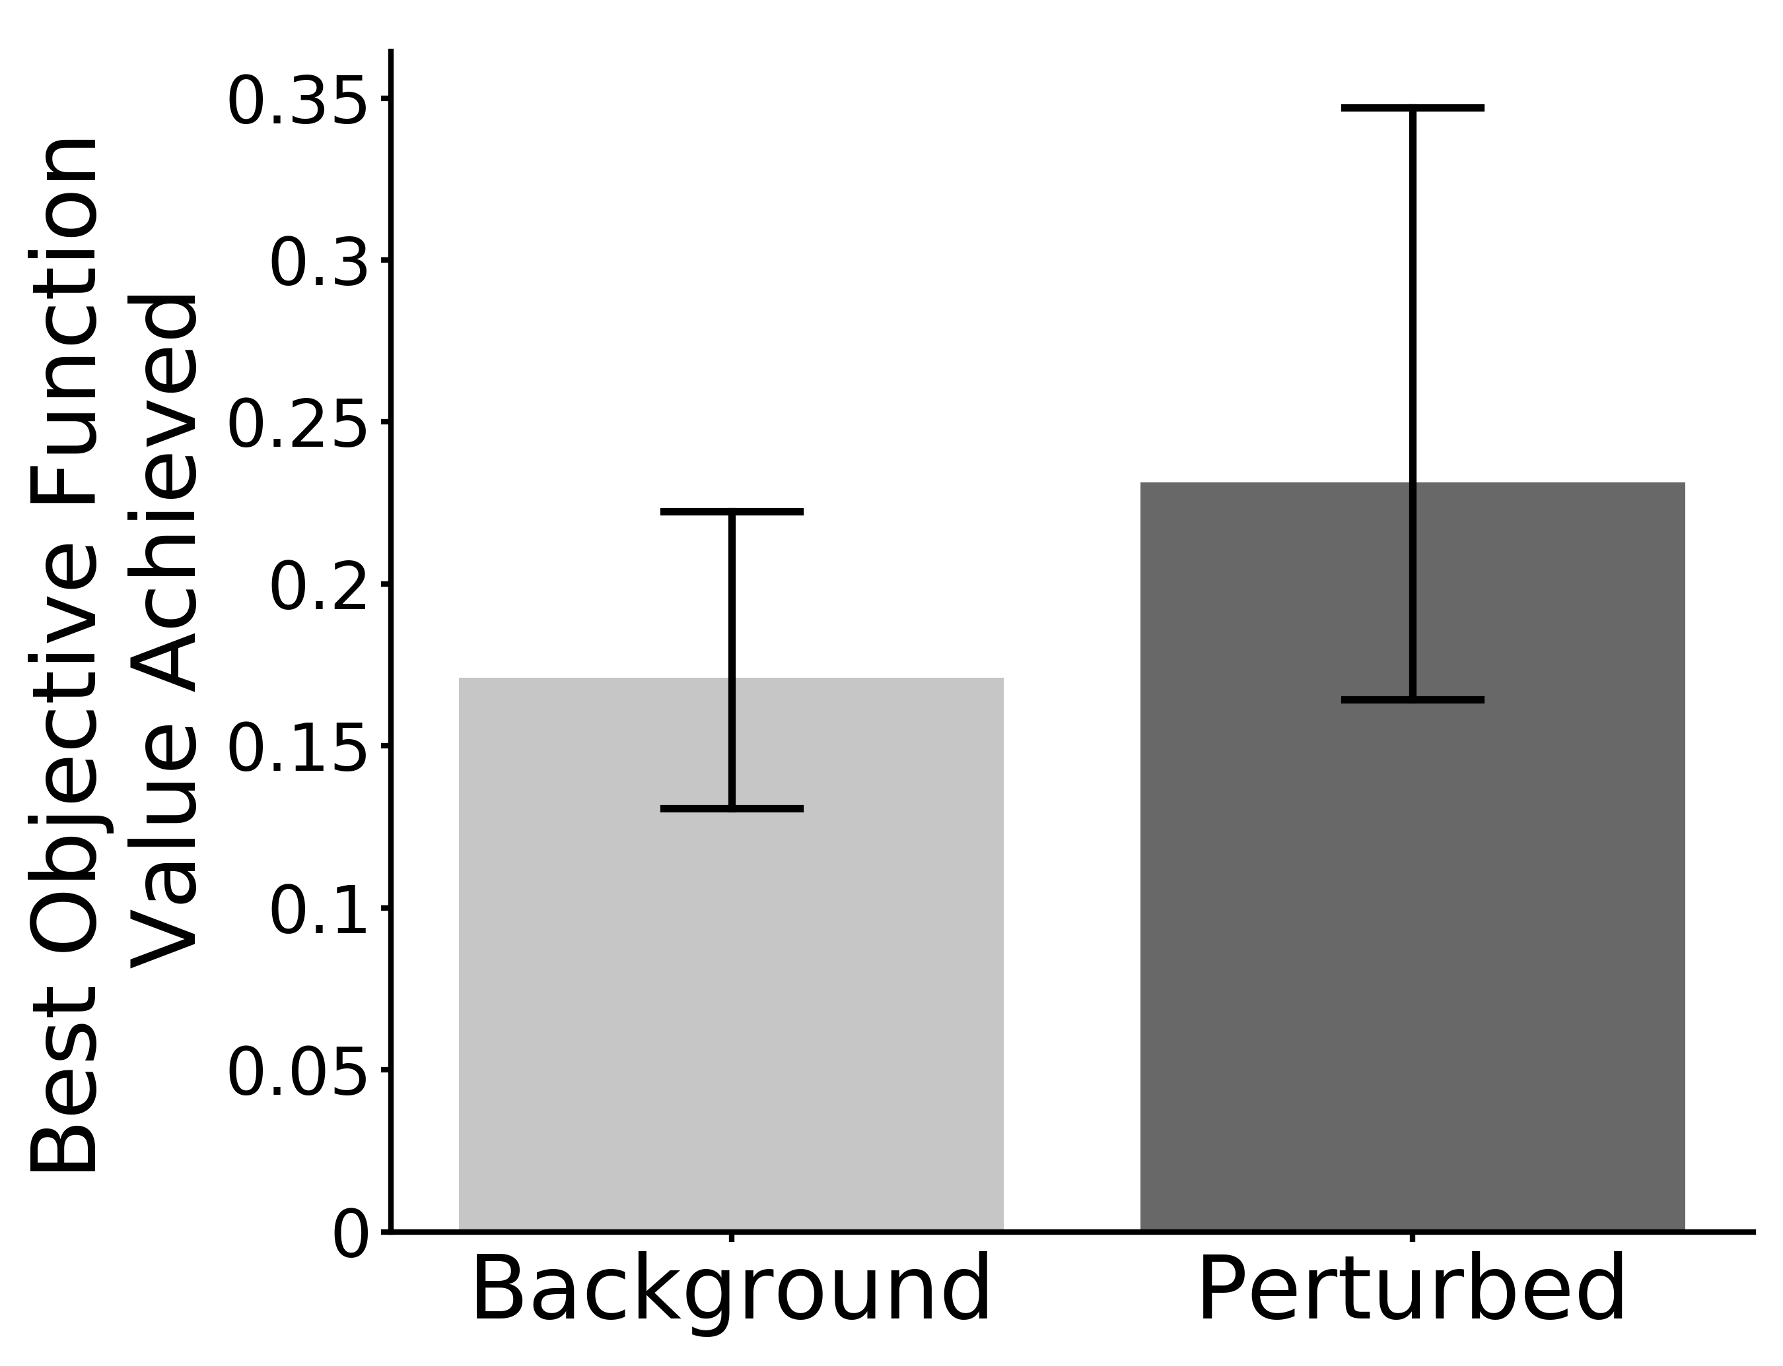
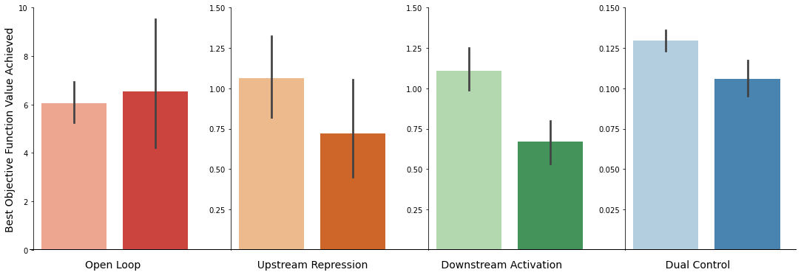
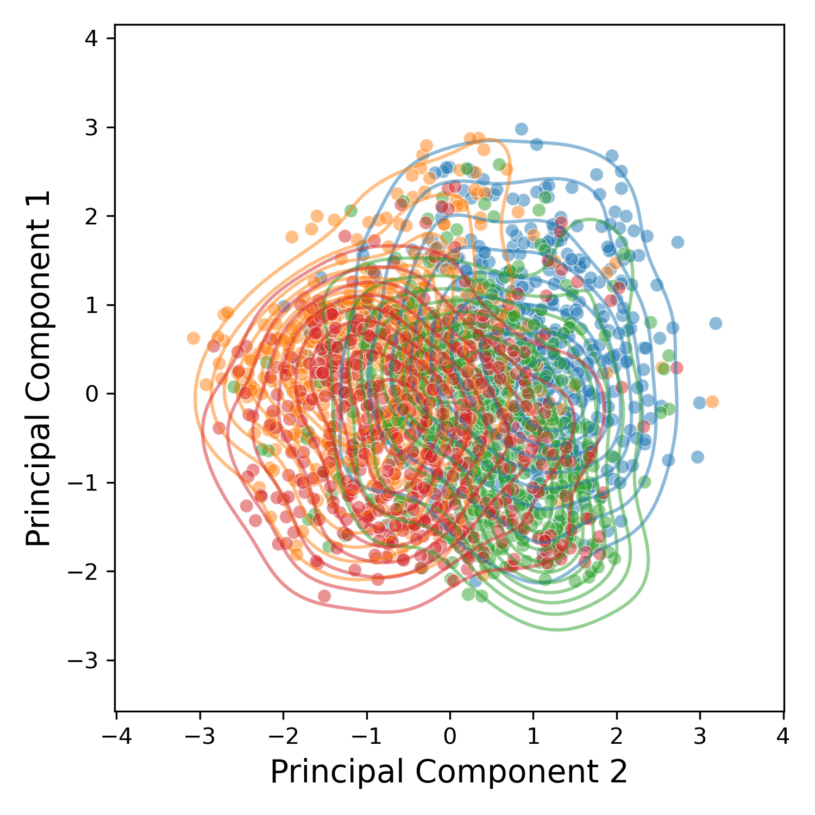
Perturbed
Background
C

Slide 14
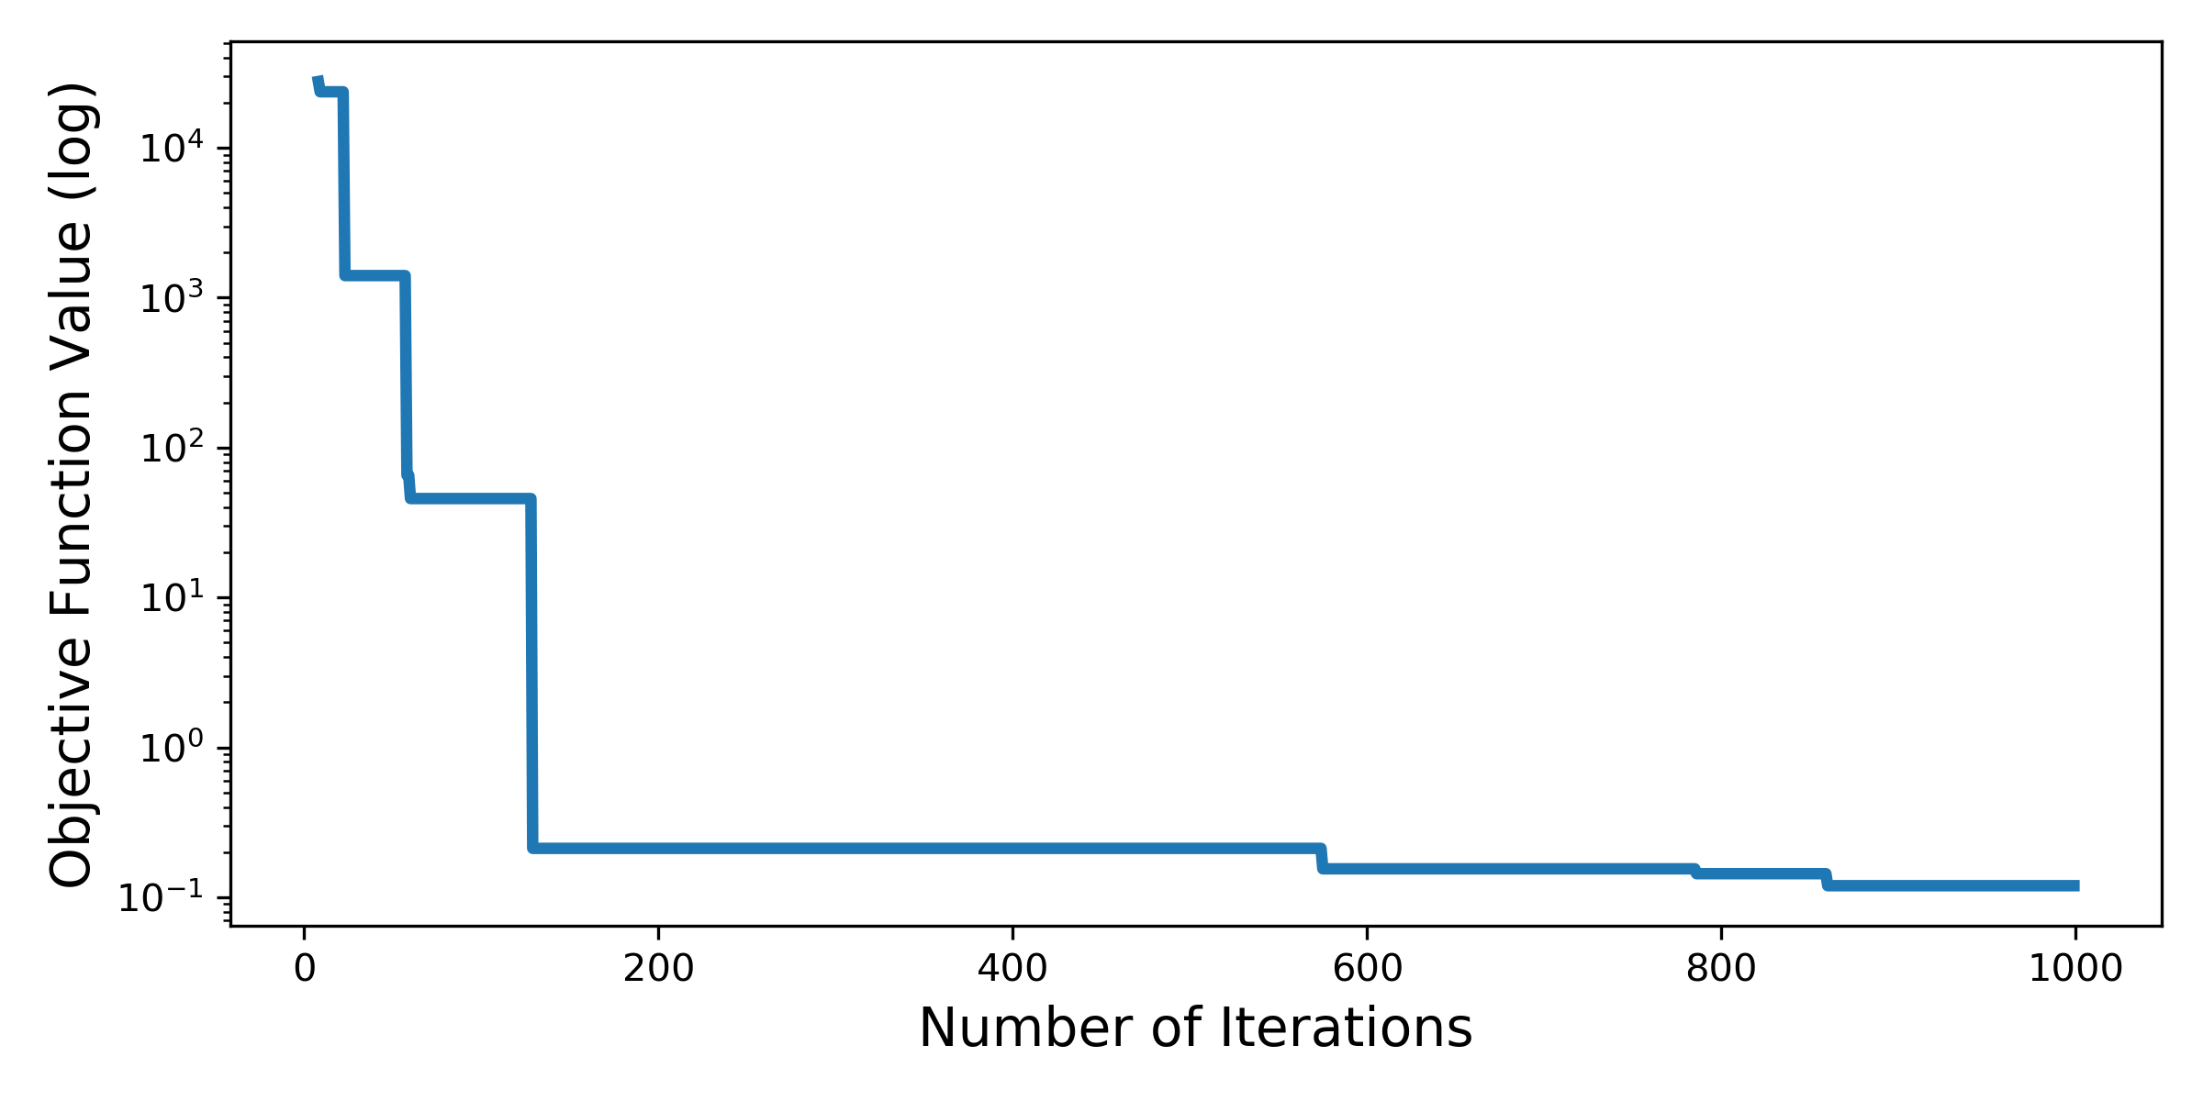
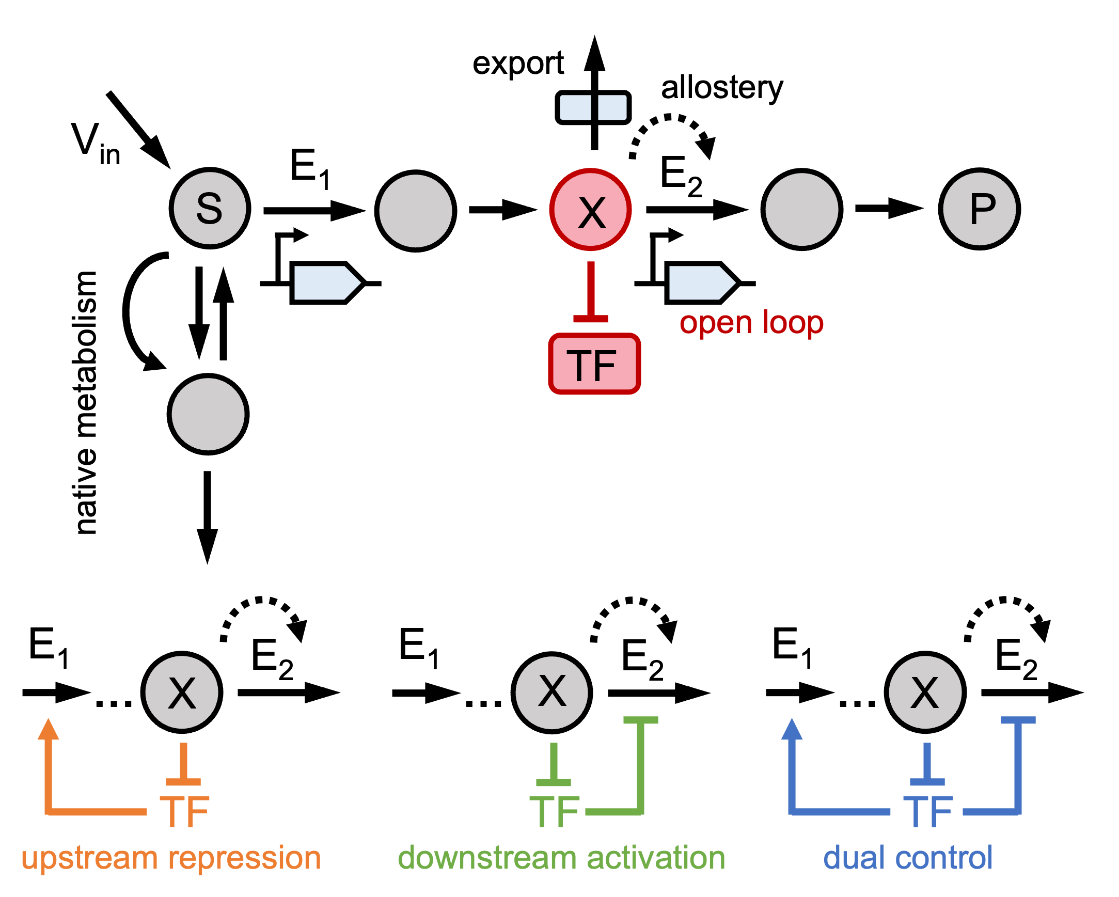
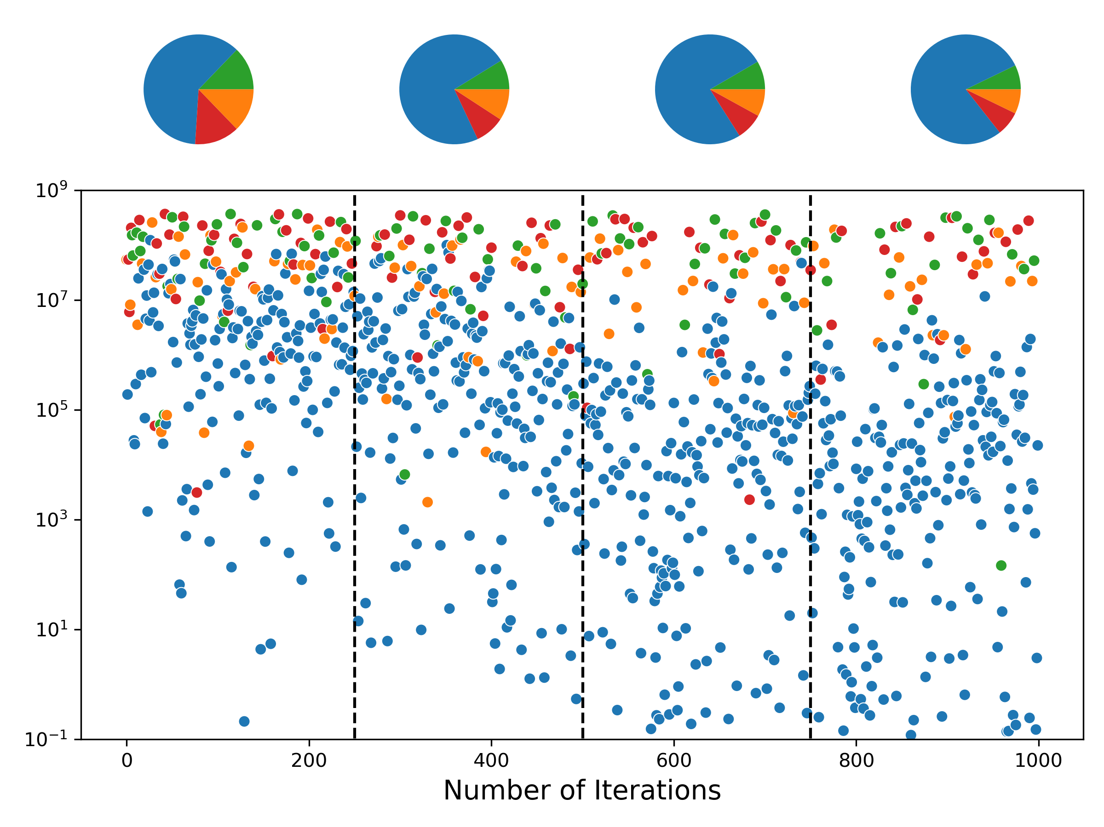
A
B
C

Slide 15
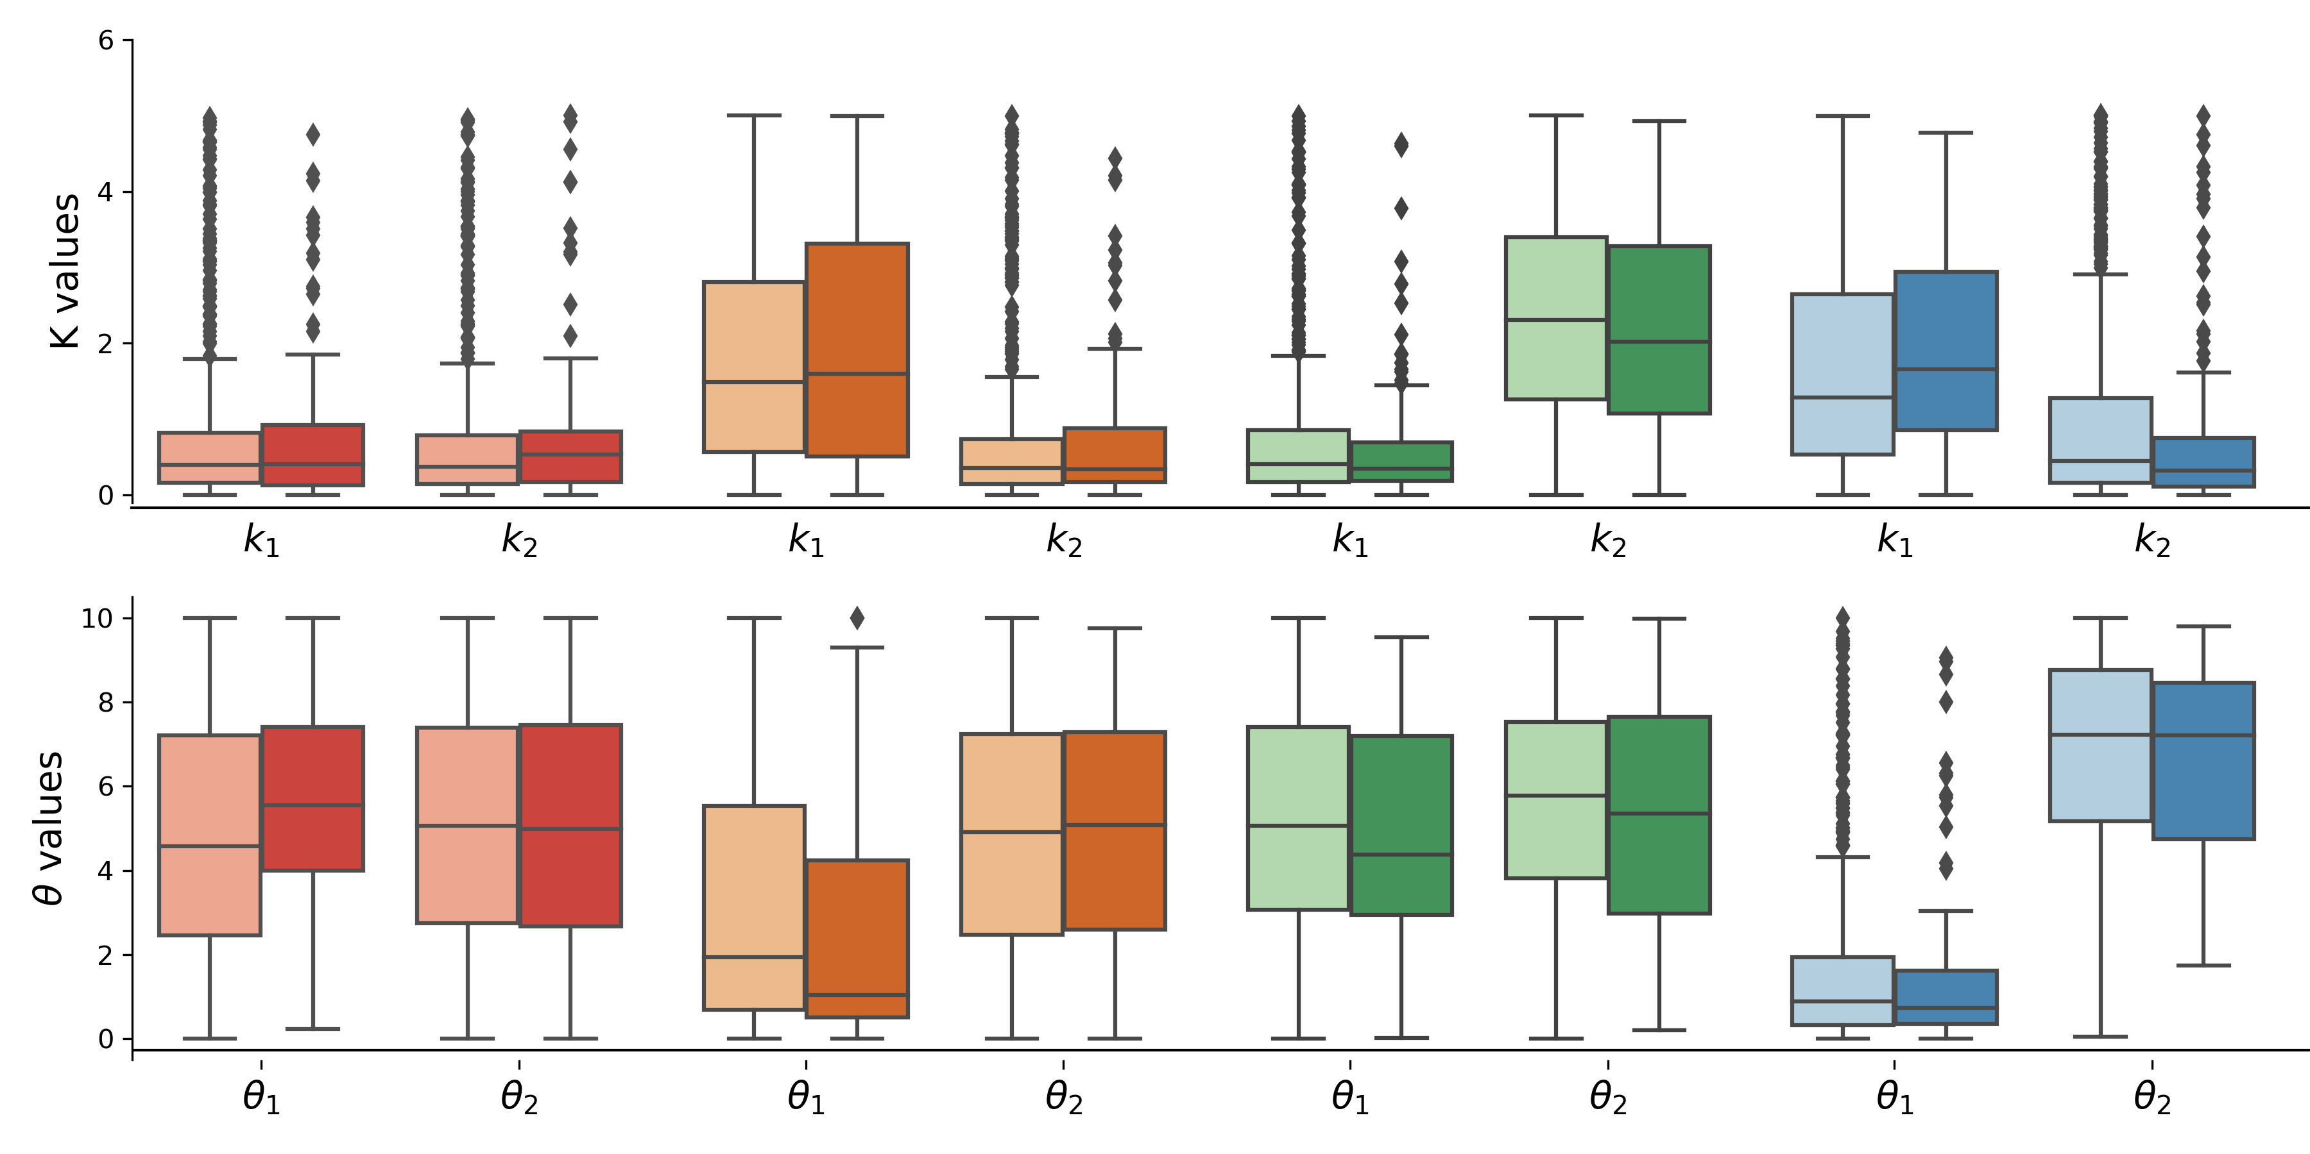
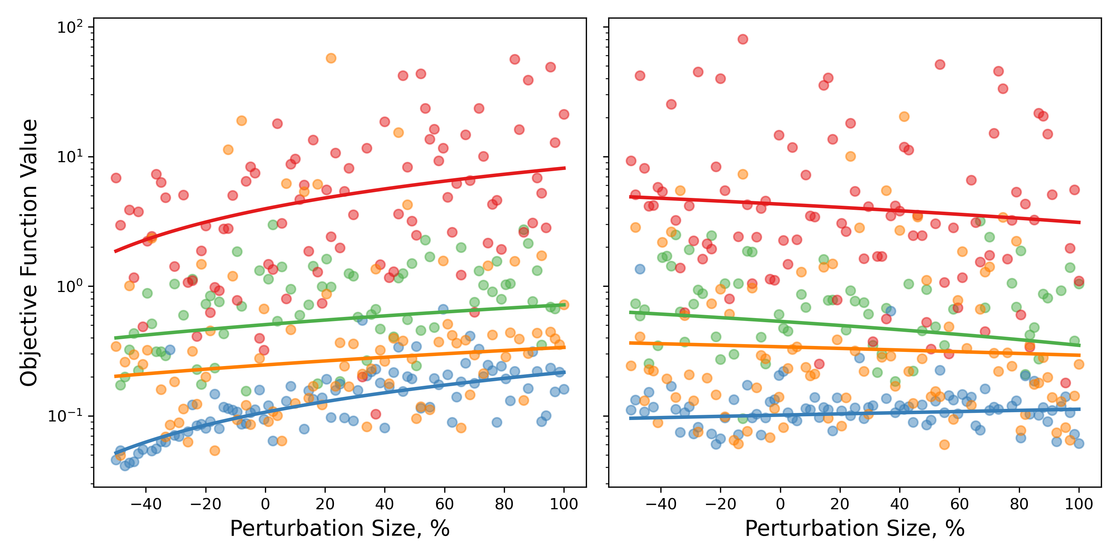
A
C
Open Loop
Upstream Repression
Downstream Activation
Dual Control
Perturbed
Background
B
D
Influx Perturbation
Export Perturbation

Slide 16
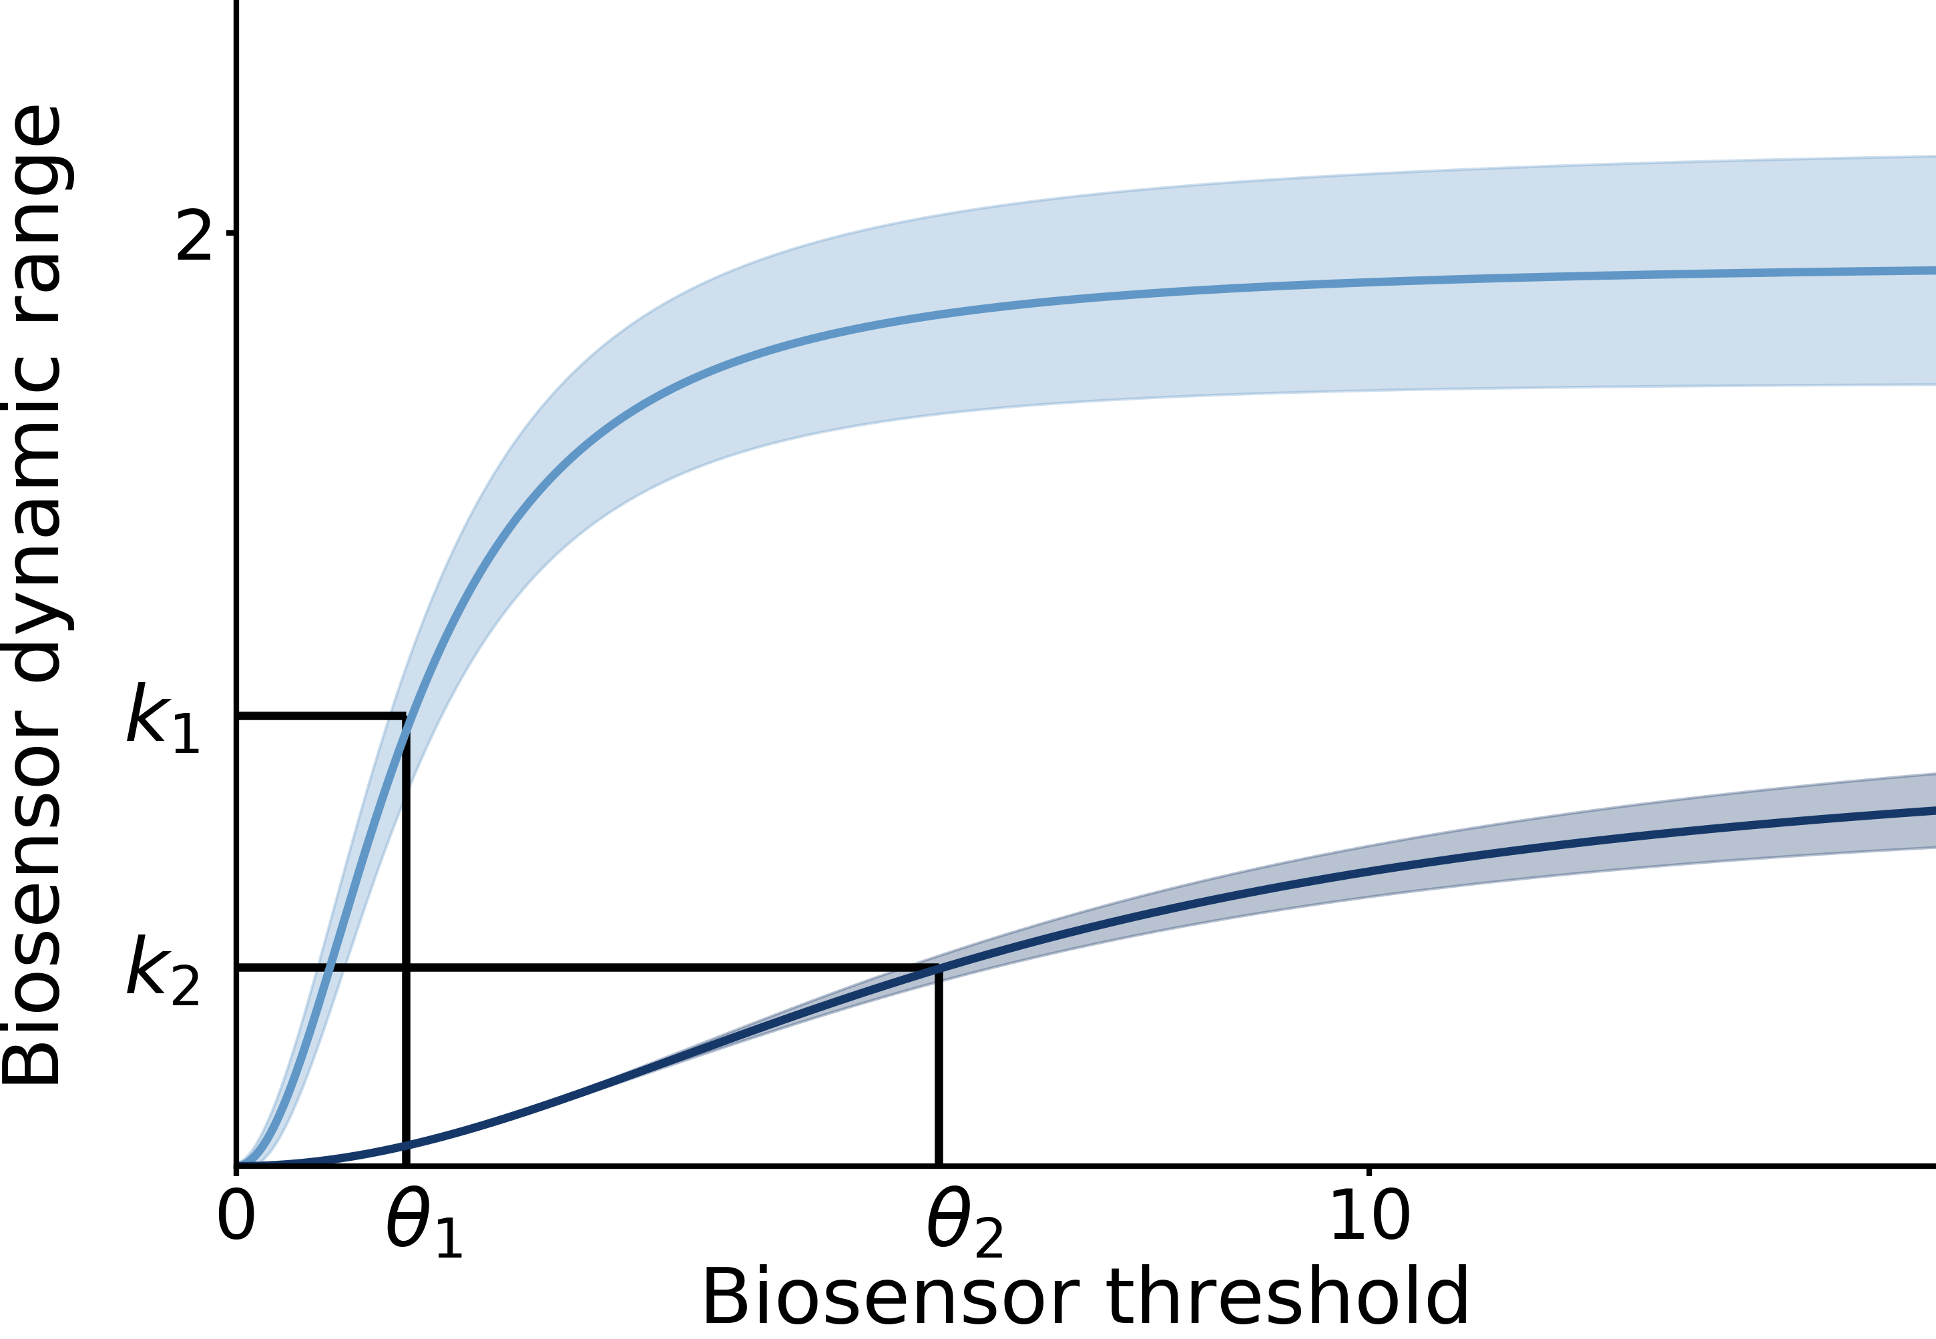
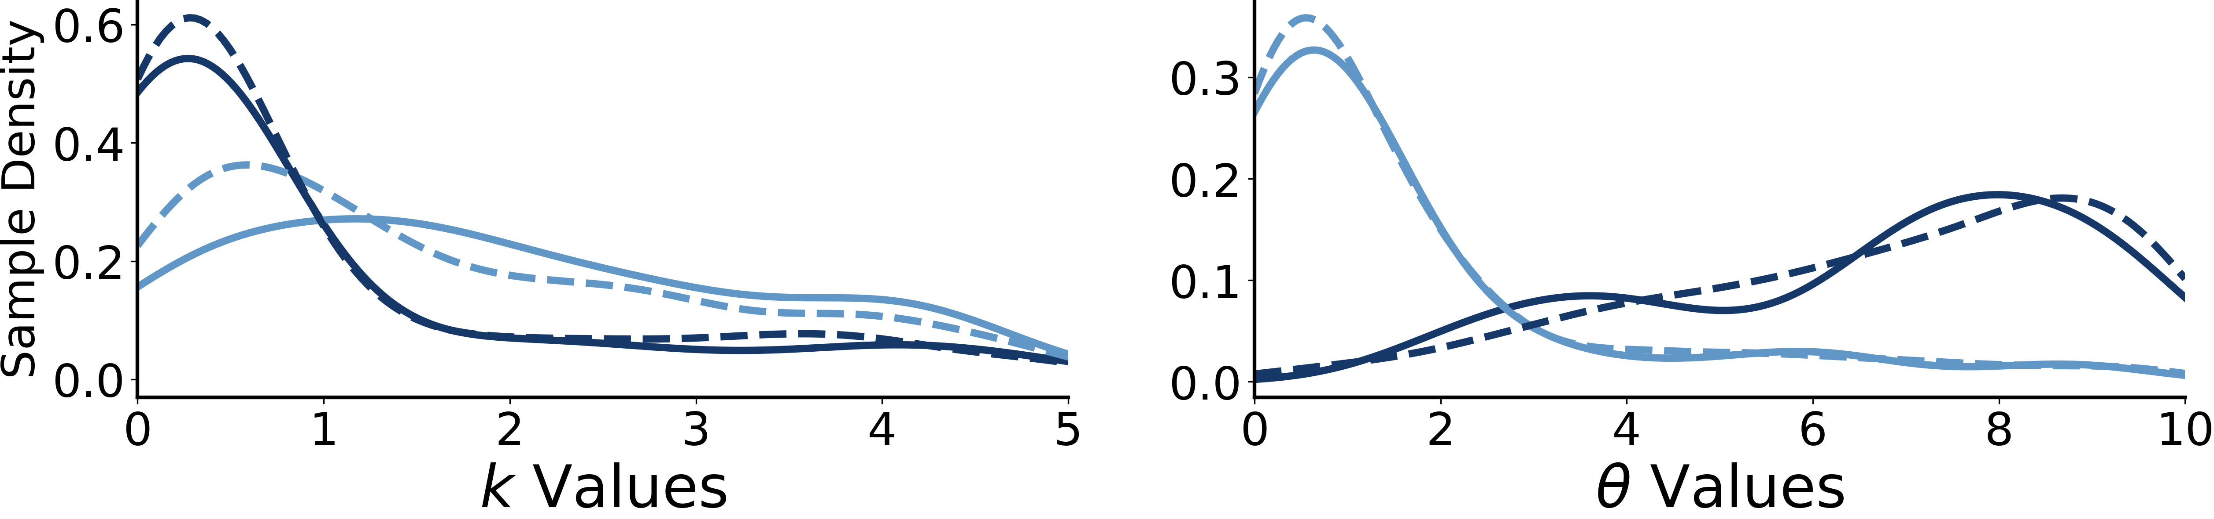
A
B
downstream loop
upstream loop
C
background
perturbed

Slide 17
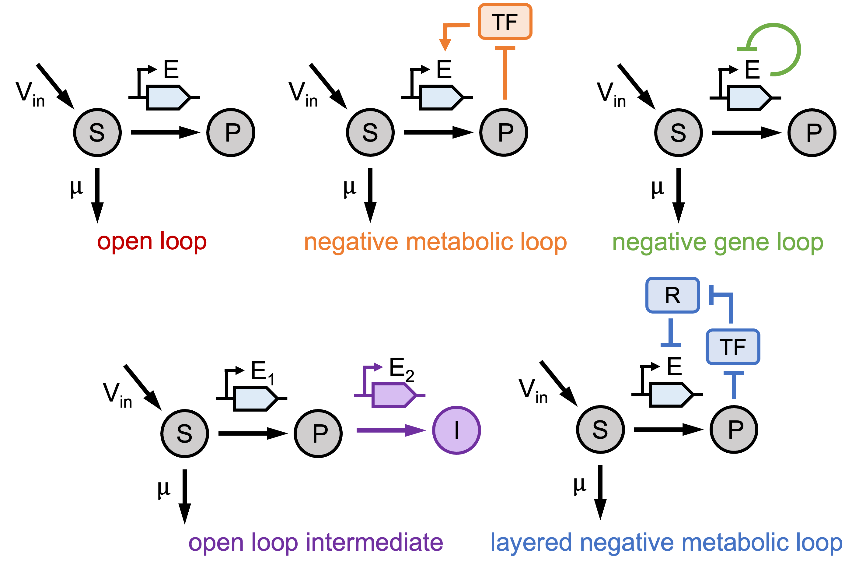
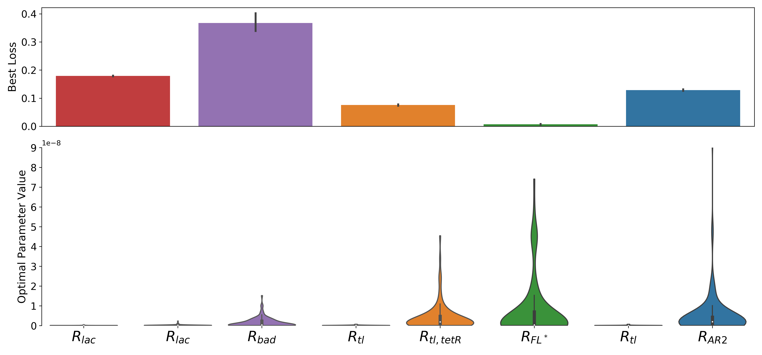
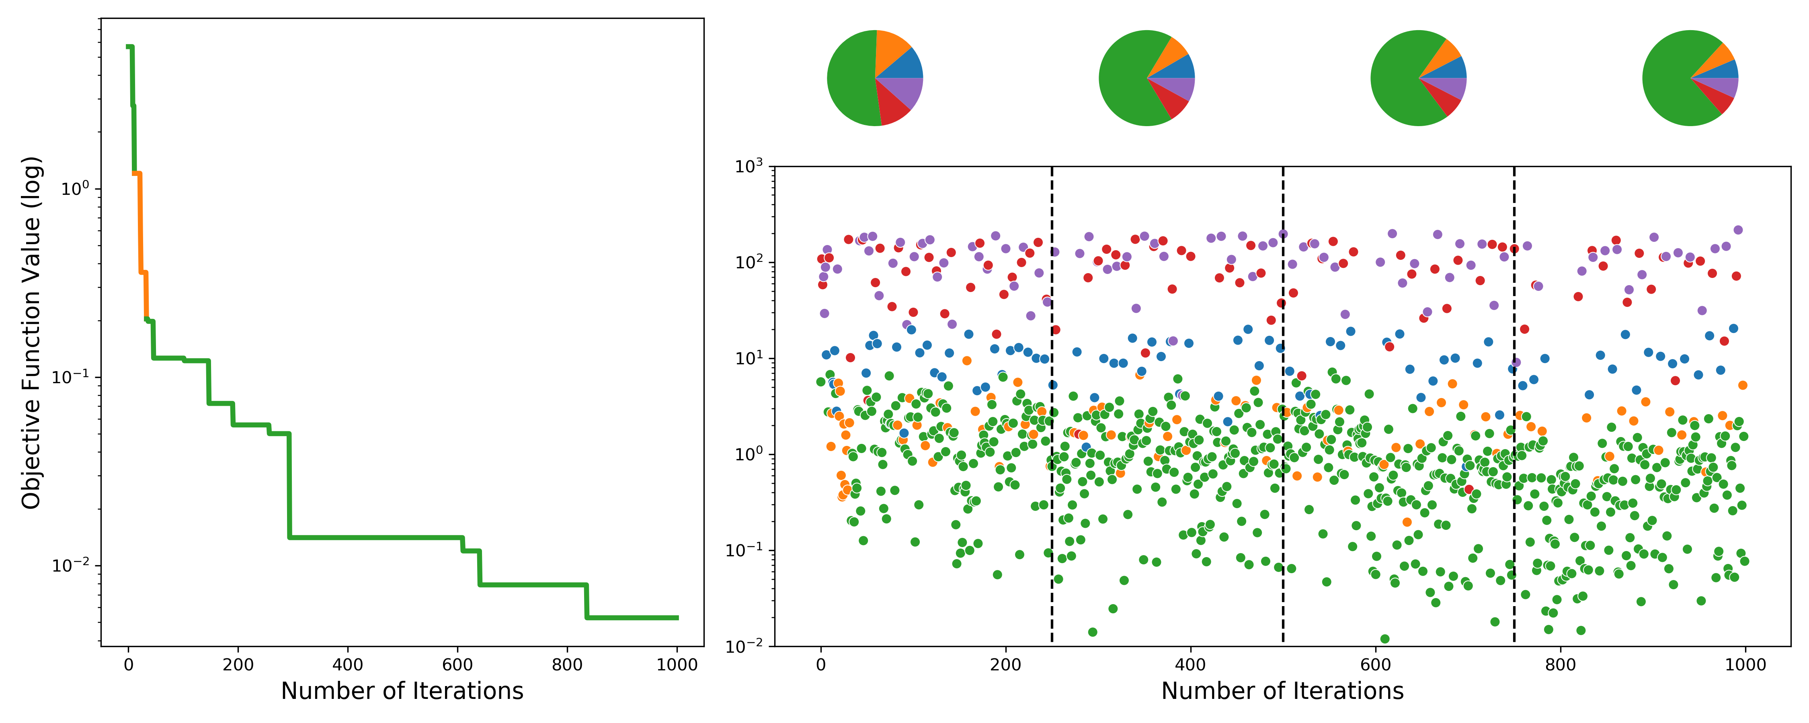
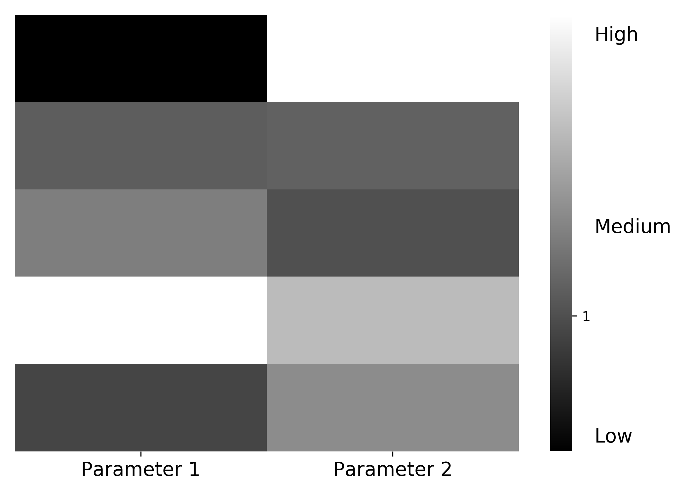
Notes:
Robustness score is invariant to mean. Instead, use coefficient of variation
Try violins/box plots for parameters
Bar plot with error bars

Slide 18
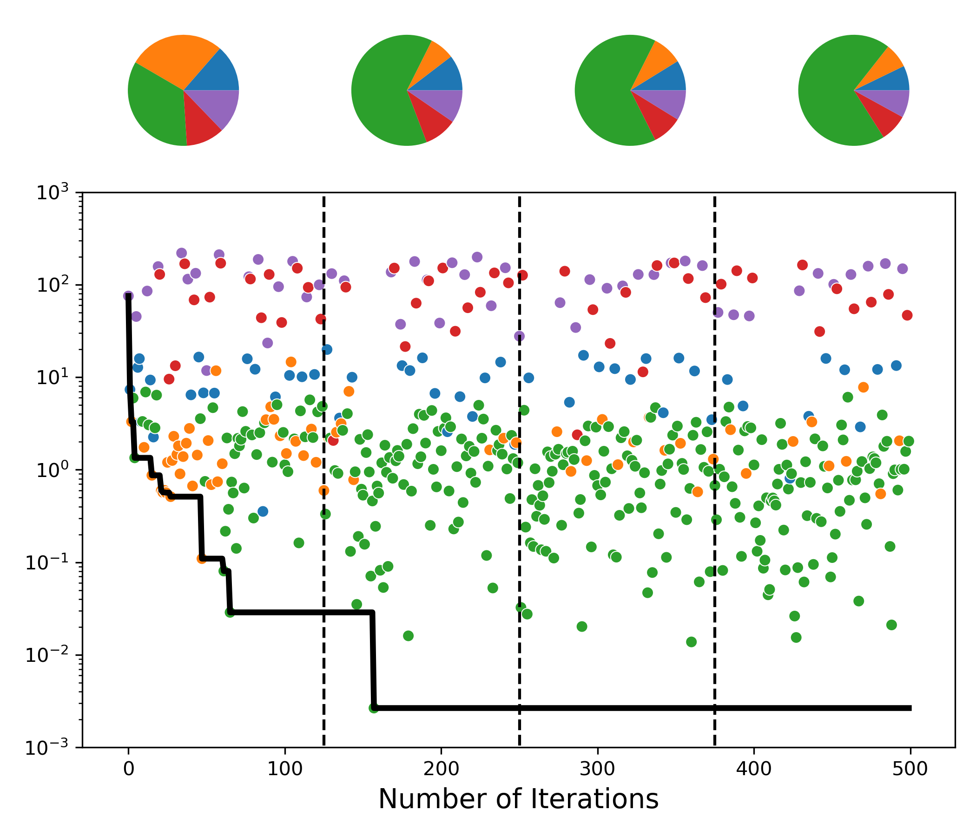

A
B
TF
E
E
E
V_{in}
V_{in}
V_{in}
S
P
S
P
S
P
$$μ$$
$$μ$$
$$μ$$
open loop
negative metabolic loop
negative gene loop
R
TF
E₁
E₂
E
V_{in}
V_{in}
S
P
I
S
P
$$μ$$
$$μ$$
C
open loop intermediate
layered negative metabolic loop

Slide 19
Raw Figures

Slide 20








$$θ_{2}$$
$$k_{2}$$
$$k_{1}$$
$$θ_{1}$$
$$k_{1}$$
$$k_{2}$$
$$k_{1}$$
$$θ_{1}$$

Slide 21
V_{in}
E₁
E₂
X_{o}
X₁
P
E₀
TF
TF
TF
open
loop
upstream
repression
downstream
activation
dual control

Slide 22
export
allostery
V_{in}
E₁
E₂
S
X
P
open loop
TF
native metabolism
E₁
E₂
E₁
E₂
E₁
E₂
…
X
…
X
…
X
TF
TF
TF
dual control
upstream repression
downstream activation

Slide 23
TF
E
E
E
V_{in}
V_{in}
V_{in}
S
P
S
P
S
P
$$μ$$
$$μ$$
$$μ$$
open loop
negative metabolic loop
negative gene loop
R
TF
E₁
E₂
E
V_{in}
V_{in}
S
P
I
S
P
$$μ$$
$$μ$$
open loop intermediate
layered negative metabolic loop

Slide 24
R_{tl, tetR}
TF
k_{i}
R_{FL’}
R_{tl}
V_{in}
V_{in}
S
P
S
P
$$μ$$
$$μ$$
negative metabolic loop
negative gene loop
R
R_{AR2}
R_{lac}
R_{bad}
TF
E
V_{in}
V_{in}
R_{tl}
S
P
I
S
P
$$μ$$
$$μ$$
open loop intermediate
layered negative metabolic loop

Slide 25

ligand sensing
TF₁
TF₂
operon
V_{in}
A
B
C
E
S
X₁
X₂
P
$$μ$$
efflux pump

